Slide 1
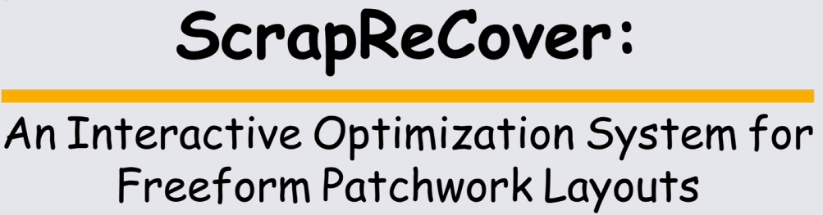


Masahiro Kono
I-Chao Shen
Maria Larsson
Takeo Igarashi
SCF 2025
Notes:
Hello everyone. My name is Masahiro Kono, and I am from the Igarashi Lab at The University of Tokyo.
Today, I would like to present my work, ScrapReCover: An Interactive Optimization System for Freeform Patchwork Layouts.

Slide 2
Contents
■ Introduction & Background
■ System Overview: ScrapReCover
- Core Feature: Interactive Optimization
- Intuitive Controls: User-Guided Sliders
■ Optimization Method: Simulated Annealing
■ Evaluation: User Study
■ Conclusion & Future work
2
Notes:
And, here is the outline for today's presentation.
First, I'll begin with the Introduction and Background, to explain our objective.

Slide 3
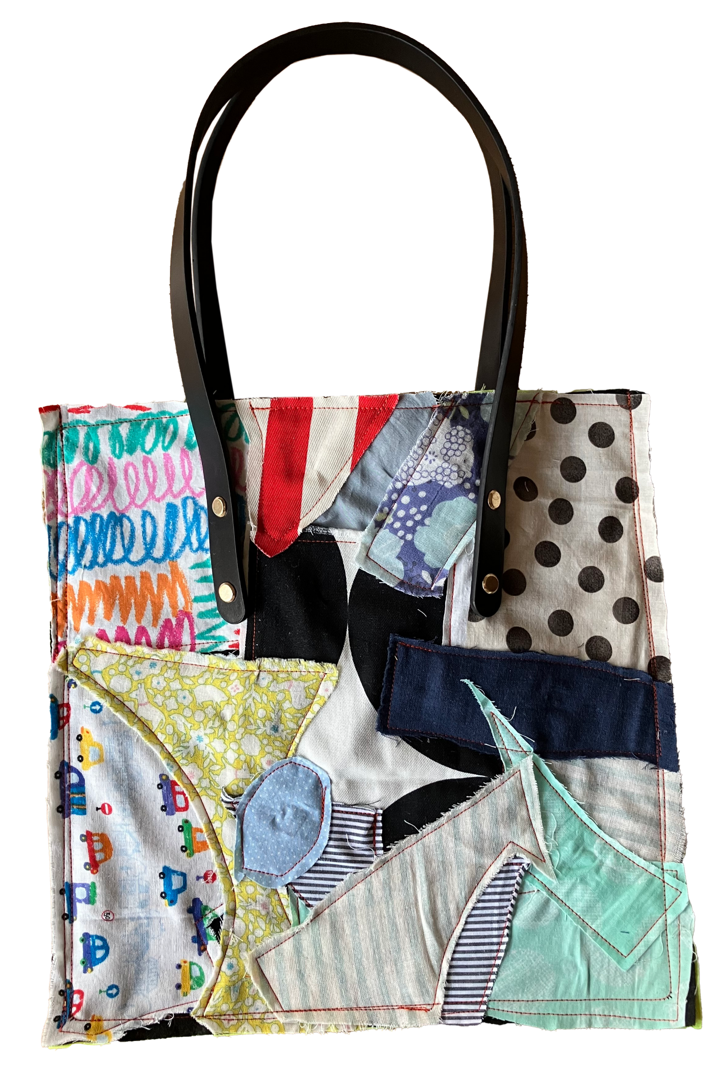
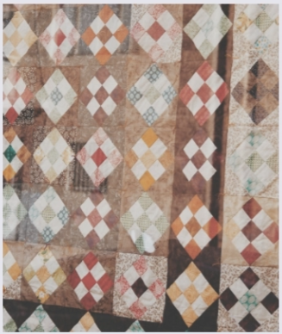
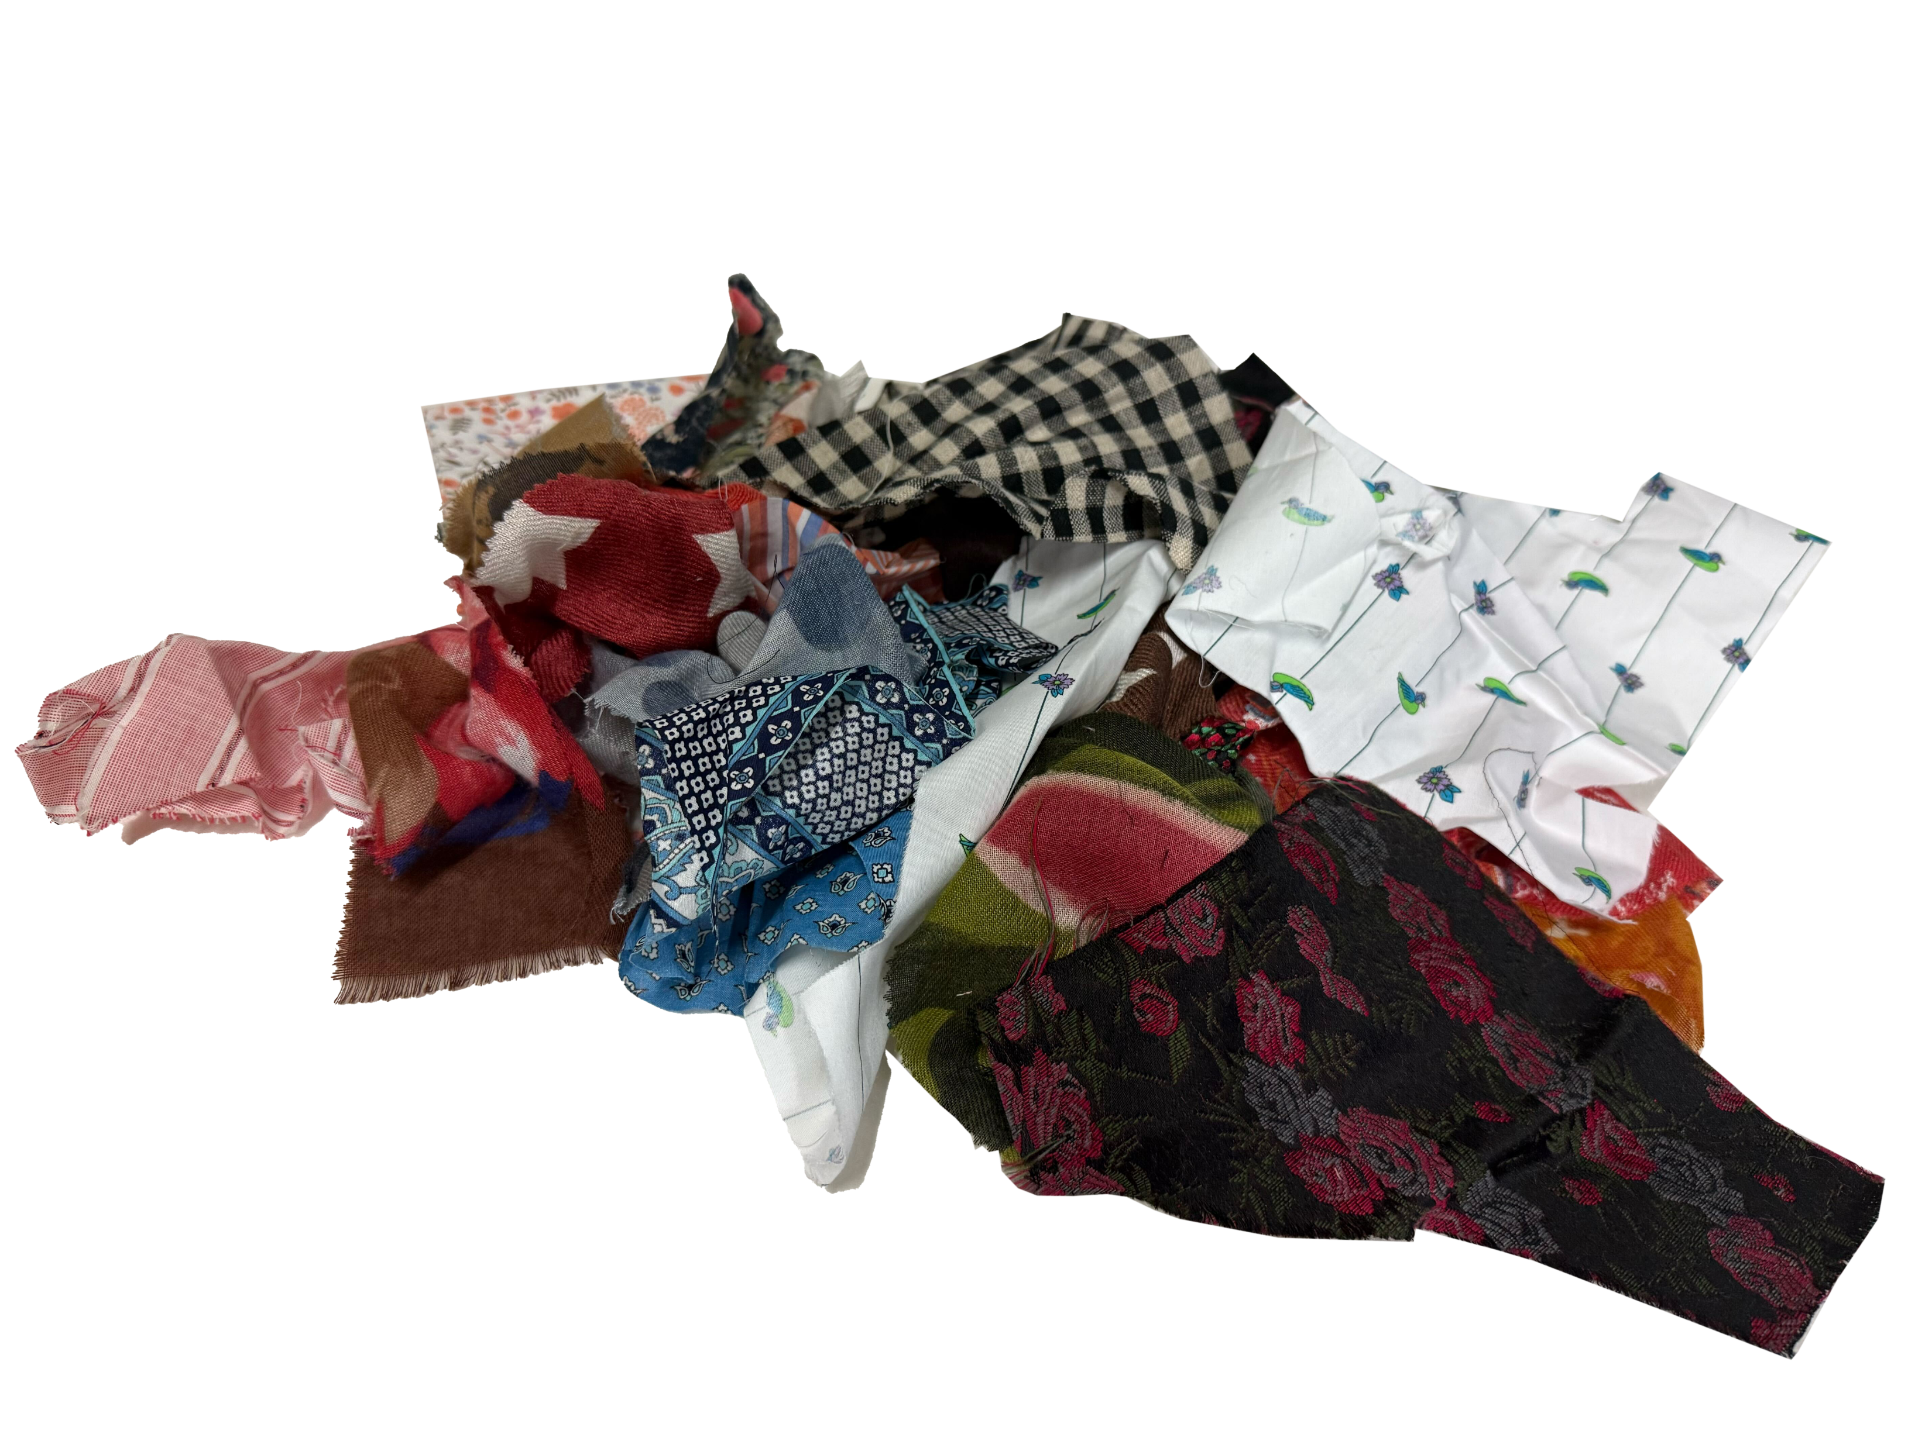
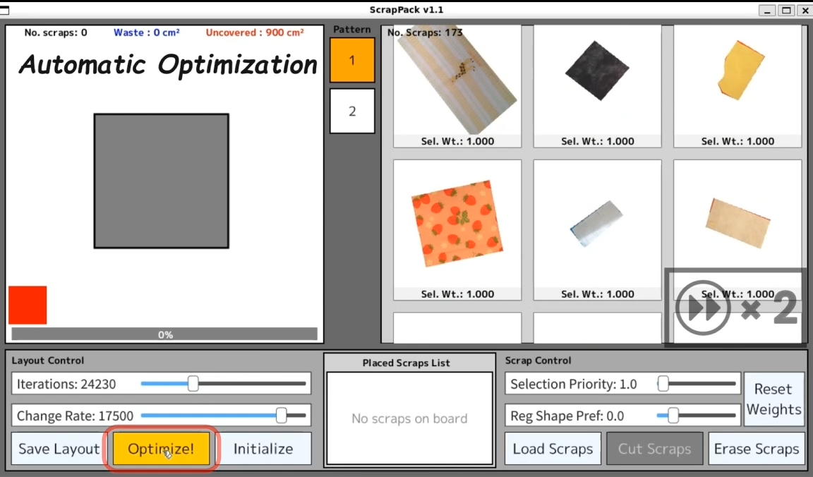
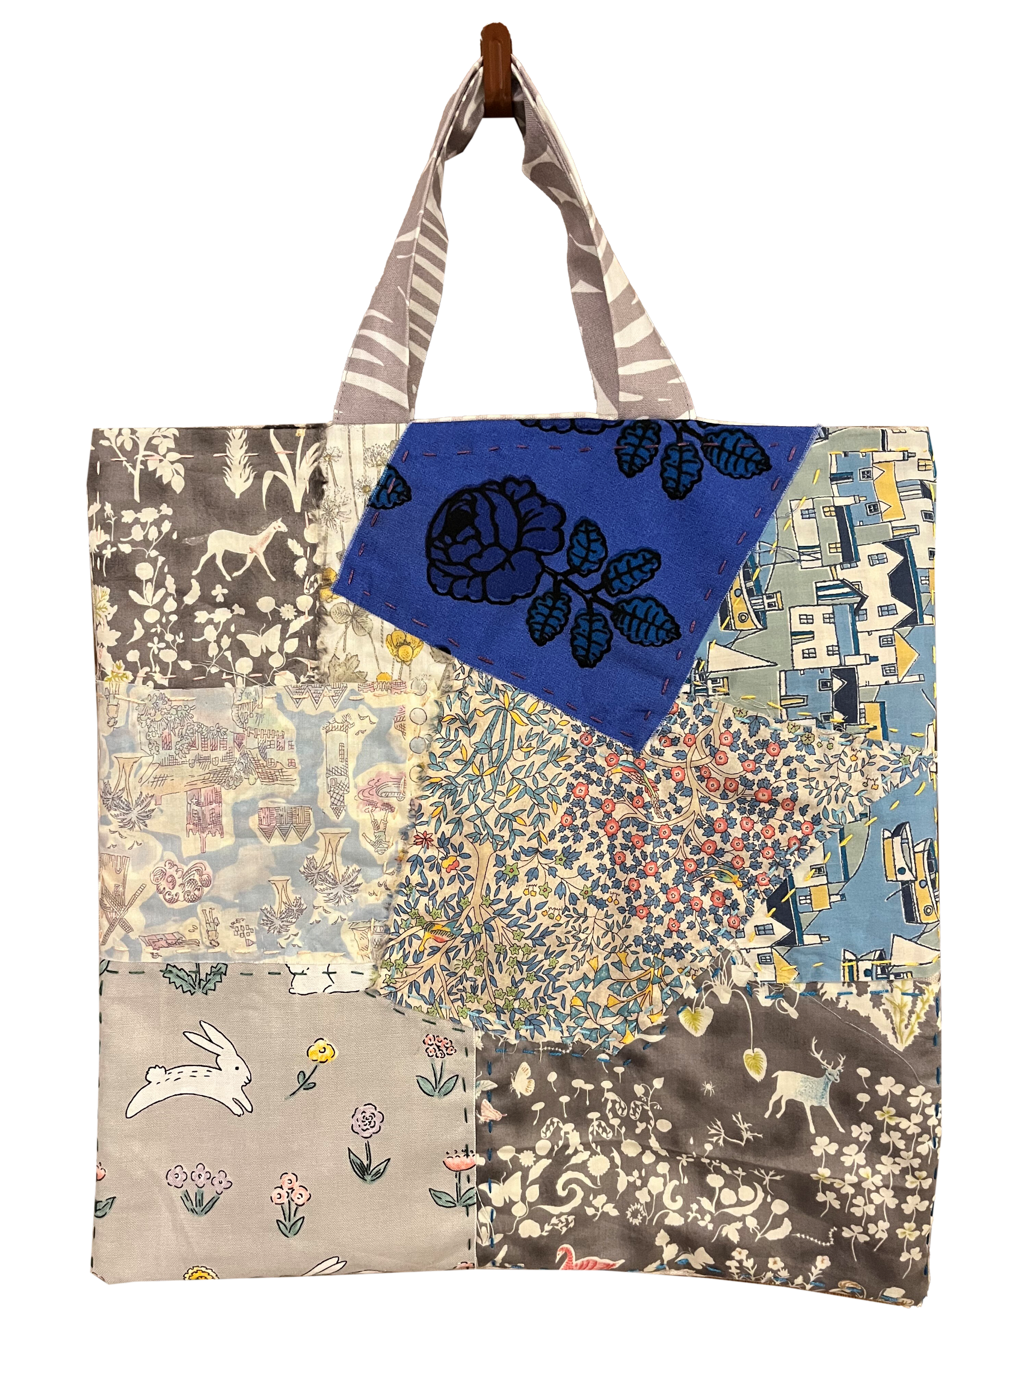
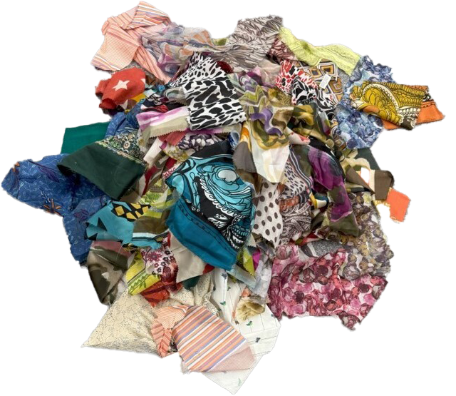
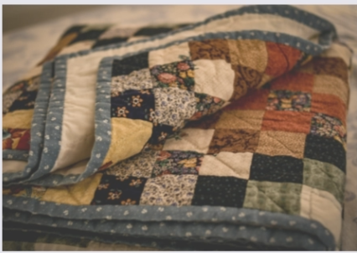
Overview of Our Objective
Reuse!
Patchwork
Fabric
scraps
Our system
(ScrapReCover)
Freeform design
Irregular shapes
Pictures from
https://www.pexels.com/photo/tiled-wall-in-close-up-shot-15337117/
https://unsplash.com/photos/white-brown-and-black-textile-1nMIYaGAnn0
3
Notes:
So, when you have leftover fabric scraps, what do you do with them? Do you throw them away, or try to make something new?
[CLICK] In fact, patchwork is a traditional technique that upcycles scraps into intricate handcrafts.
[CLICK] Here, our system, ScrapReCover, is an interactive tool for patchwork, focusing on creating freeform layouts from these irregular scraps.
[CLICK] The key feature is its iterative process, where users seamlessly combine manual adjustments with automatic suggestions and control with sliders to create unique designs.

Slide 4
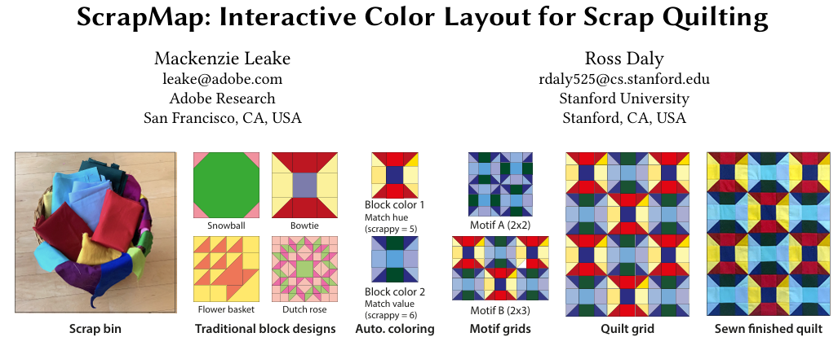
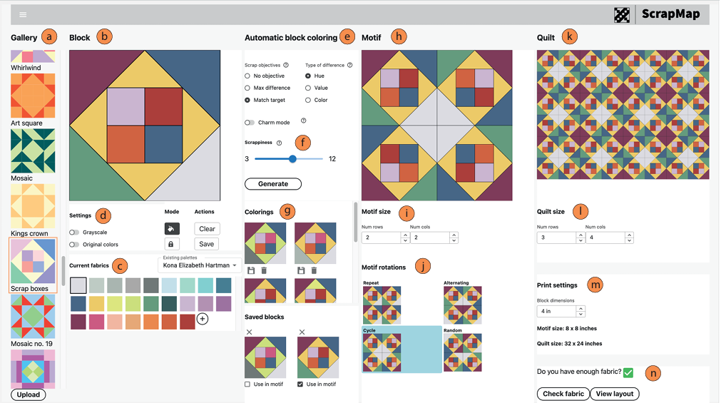
Related Work
ScrapMap: Interactive Color Layout for Scrap Quilting [Leake et al. UIST‘24]
Reuse!
Patchwork
Fabric
scraps
ScrapMap
[Leake+ ‘24]
Repetitive design
Regular shapes
4
Notes:
Next, let's take a look at the existing approaches.
Most systems for patchwork design, like ScrapMap, are designed for traditional styles.
Their entire workflow is built around regular shapes—like these square grids—to create repetitive patterns.
In contrast, our work focuses on creating freeform layouts directly from the irregular shapes of a user's available scraps.

Slide 5
Contents
■ Introduction & Background
■ System Overview: ScrapReCover
- Core Feature: Interactive Optimization
- Intuitive Controls: User-Guided Sliders
■ Optimization Method: Simulated Annealing
■ Evaluation: User Study
■ Conclusion & Future work
5
Notes:
( min~)
Now, let's move on to the the main part — the overview of the user interface and workflow of ScrapReCover.

Slide 6
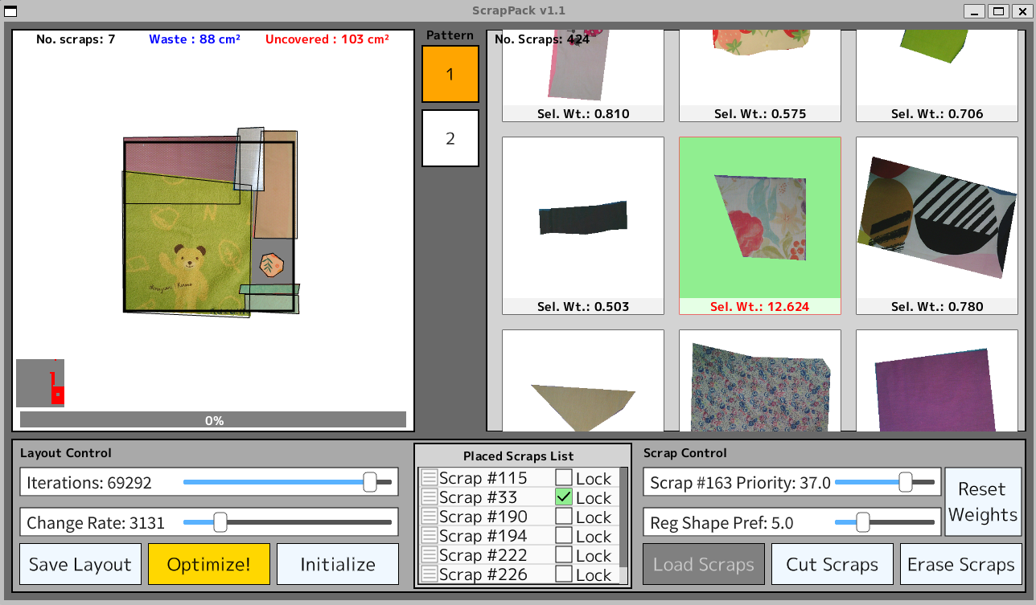
Overview of The User Interface
a. Layout workspace
b. Available scraps list
a
b
c. Layout control panel
d. Placed scraps list
e. Scrap control panel
c
d
e
Notes:
The interface of ScrapReCover consists of five components:
[CLICK] First, the Layout Workspace. This is the main canvas where you manually arrange scraps and see the optimization results.
[CLICK] Next, we have the Available Scraps List. This shows all your unused scraps, which you can drag into the workspace.
[CLICK] Third, is the Layout Control Panel. This contains the global controls, including the 'Optimize' button and sliders for the optimization process.
[CLICK] And Forth, the Placed Scraps List. This lists all scraps currently in the layout and allows you to lock their placements.
[CLICK] And finally, the Scrap Control Panel. This panel lets you manage individual scrap properties, or load and edit your scrap data.

Slide 7
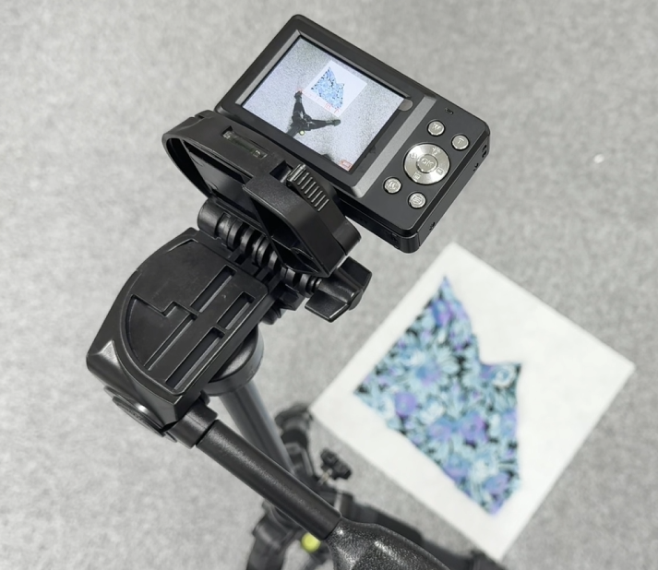
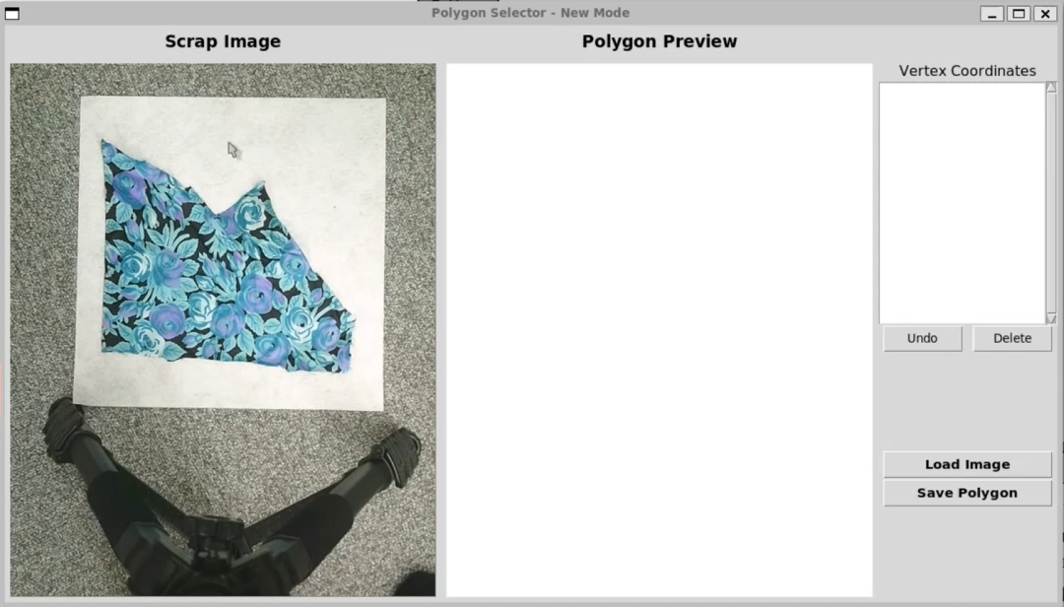
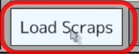
Preparation
Scrap Registration
Manually outline the desired scrap shape like cutting
Notes:
As a preparation step, the workflow begins with photographing scraps using a fixed camera.
[CLICK] By clicking the Load Scraps button, users launch the segmentation interface to manually outline the desired portion of each scrap as a digital polygon to import them into the system.
And Users can return to this step anytime, just like trimming fabric scraps in real-world.

Slide 8
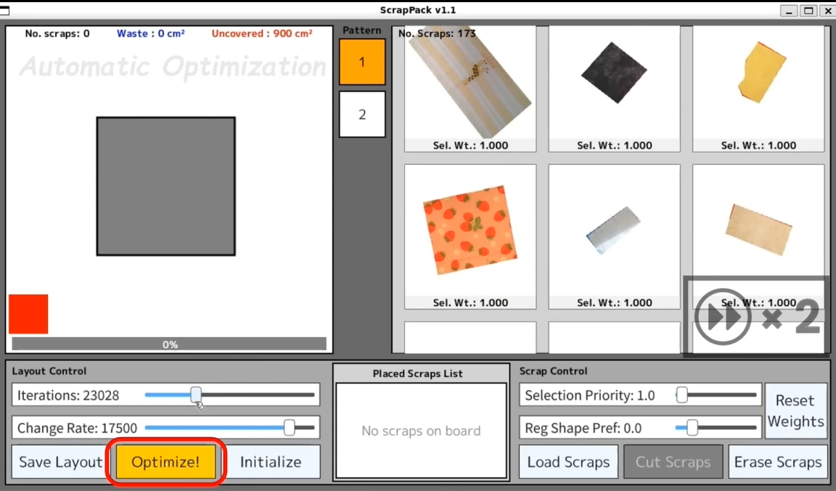
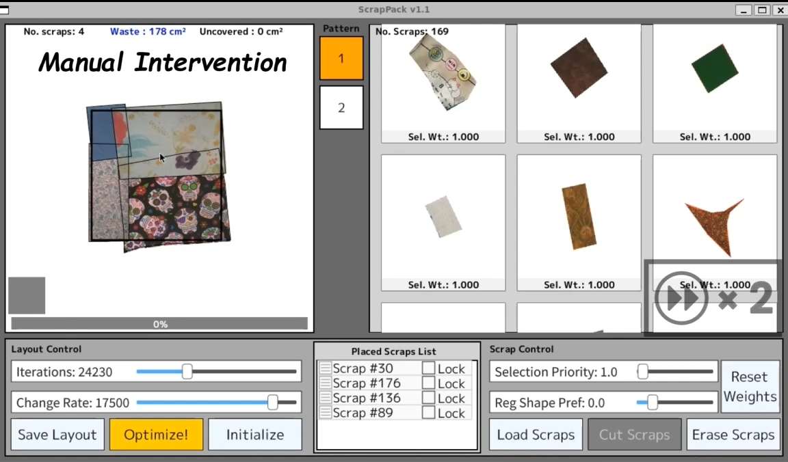
Interactive Optimization
Automatic Optimization +
Manual Adjustments
Complete coverage & min waste
Move, rotate, lock the position etc.
Notes:
The key feature of ScrapReCover is its interactive optimization.
[CLICK] Users can initiate an automatic layout suggestion, which gradually transforms a scattered layout into a more densely packed arrangement.
[CLICK] The system also supports manual adjustments, such as moving, rotating, or locking the position of any scrap.
By seamlessly combining these features, users can iteratively refine their designs.

Slide 9
Contents
■ Introduction & Background
■ System Overview: ScrapReCover
- Core Feature: Interactive Optimization
- Intuitive Controls: User-Guided Sliders
■ Optimization Method: Simulated Annealing
■ Evaluation: User Study
■ Conclusion & Future work
9
Notes:
(min~)
Next, I'd like to talk about the 'User-Guided Sliders', which serve as the 'Intuitive Controls' for our system.

Slide 10
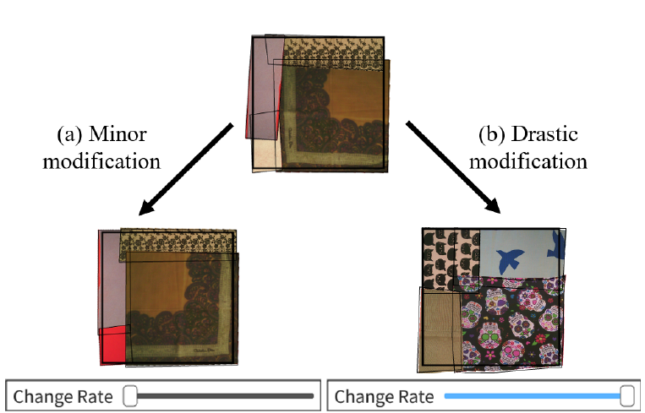
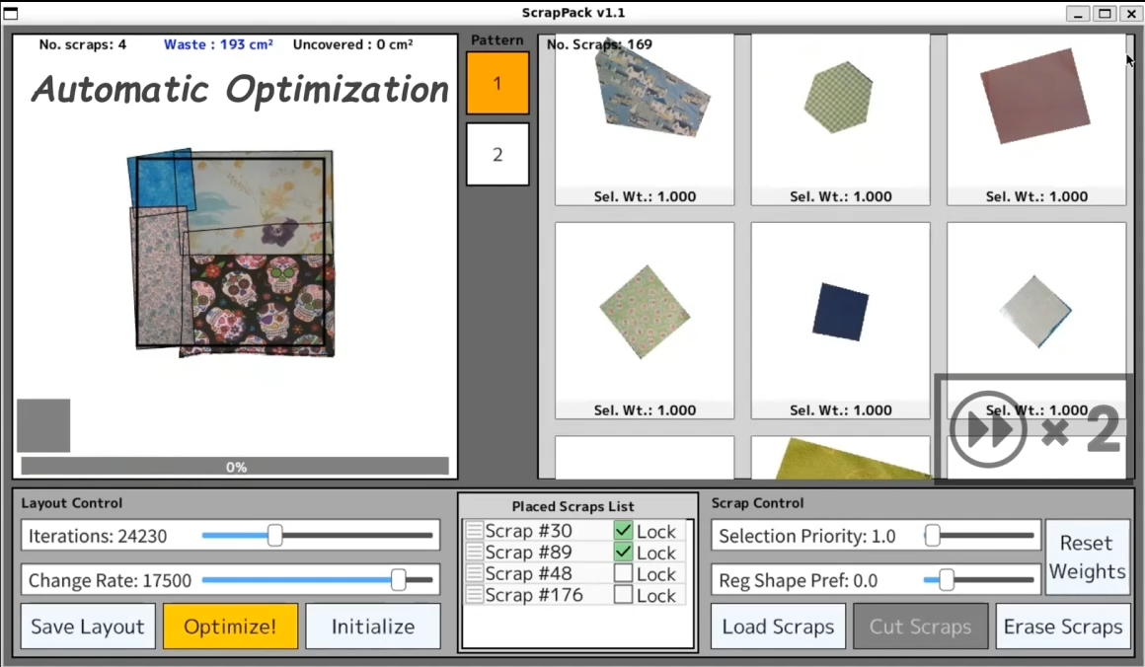
Intuitive controls for the optimization
Global layout control
Change rate slider
[Low value]
Minor
modification
[High value]
Drastic
modification
Notes:
The 'Change Rate' slider is a key control for the optimization. It translates the user's intent into how much modification is desired for the current layout.
[CLICK] A low value is for minor modifications, allowing them to fine-tune the current layout.
In Contrast, A high value is for drastic modifications, which lets them see a completely new arrangement.
This slider provides users with flexible design control.

Slide 11
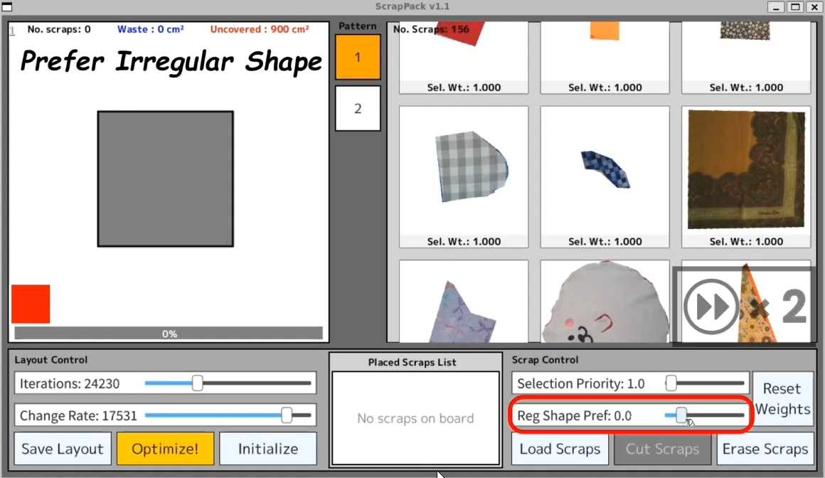
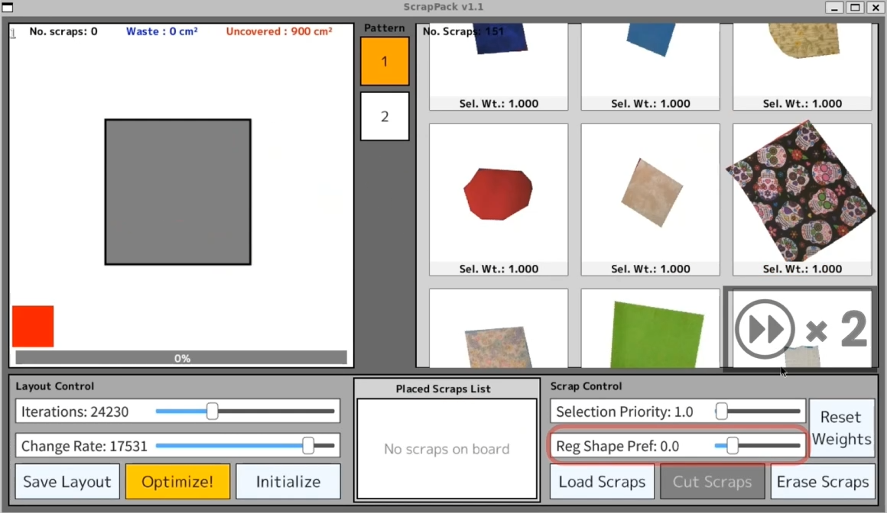
Intuitive controls for the optimization
Scrap Prioritization
Reg. shape pref. slider
[Low value]
Prioritize irregular shapes
[High value]
Prioritize regular shapes
Notes:
Since manually selecting scraps can be time-consuming, our system provides two controls to assist.
[CLICK] First, the Regular Shape Preference slider globally adjusts what type of scrap to prioritize.
Setting a low value tells the system to focus on irregular shapes, or the non-uniform ones.
[CLICK] In contrast, a high value tells the system to favor regular shapes, like simple rectangles.

Slide 12
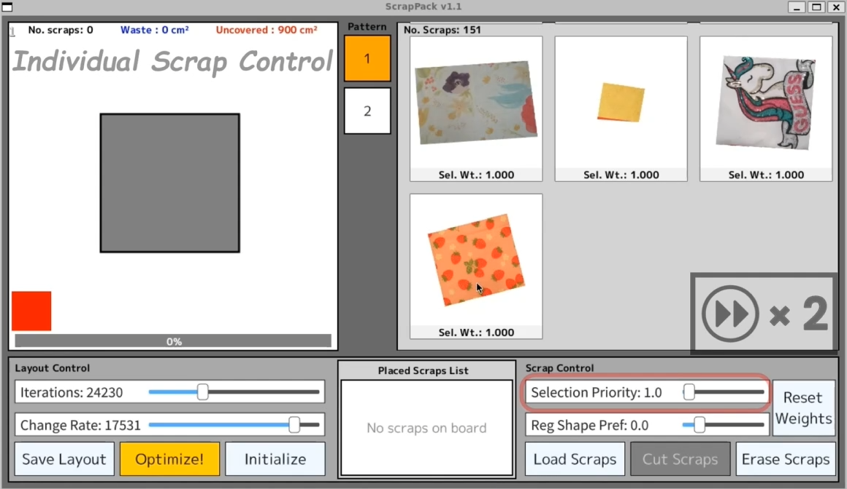
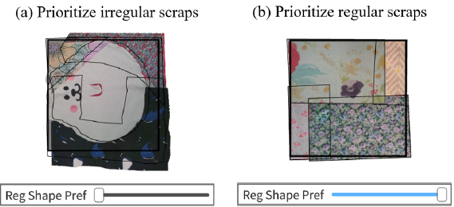
Intuitive controls for the optimization
Selection priority slider
+
Reg. shape pref. slider
(previous slide)
Control individual scraps
Control overall scraps
Notes:
Second, the 'Selection Priority' slider lets the user adjust the priority of an individual scrap.
By combining these controls, users can effectively guide the optimization that match their design goals.

Slide 13
Contents
■ Introduction & Background
■ System Overview: ScrapReCover
- Core Feature: Interactive Optimization
- Intuitive Controls: User-Guided Sliders
■ Optimization Method: Simulated Annealing
■ Evaluation: User Study
■ Conclusion & Future work
13
Notes:
(min~)
Next, I’d like to explain our Optimization Method, which is based on Simulated Annealing.

Slide 14
Problem Setting for Optimization
Limited Scraps
Input
  - Scraps: Arbitrary-shaped polygons (Small)
  Pattern: Arbitrary-shaped polygons (Large)
  User specification (slider parameters)
Output
  - Placement (approximate solution/multiple suggestions)
Objective and Constraint
(waste = overlapping, outside of the board)
Pattern
Completely
Cover
Low-waste
Placement
$$minimize:{waste s.t. no uncovered area }$$
Notes:
The problem can be formulated as follows:
As input, we are given smaller polygons corresponding to scraps, and larger polygons corresponding to the pattern.
[CLICK] Then, the goal is to output a placement that satisfies the constraint of completely covering the pattern, while minimizing waste.
Here, we will define “waste” as overlaps and areas outside of the board.
Since, the solution space will be very large, we are aiming to find an approximate solution

Slide 15
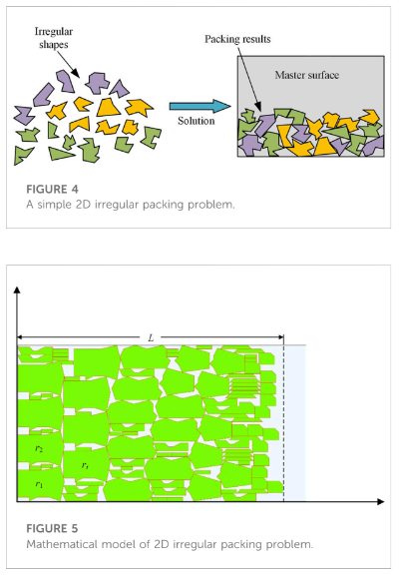
Comparison with Traditional Problems
Packing problem
- 1D, 2D, 3D (Dimension)
- regular, irregular (Shape)
2D ＆ irregular (Nesting problem)
- Pack non-rectangular polygon into 2D space
- Minimize length while width fixed
- Do not Allow overlaps
・Our problem setting
- Aims to cover all space
- Allows overlaps
→ Fundamentally Different Problem!
Two-dimensional irregular packing problems: A review
[Guo et al. Frontiers in Mechanical Engineering 8 ‘22]
Notes:
Before introducing the proposed method, I would like to compare it with a related classical problems.
The packing problem is a well-known problem in discrete optimization, and while its objective is to utilize empty space as much as possible, it does not allow any overlaps.
[CLICK] In contrast, our problem setting allows overlaps, and aims to completely cover the given area, which means that it is a fundamentally different problem, though highly related.

Slide 16
Proposed Method
Simulated Annealing [Kirkpatrick ‘83] -based
- Meta-heuristic ＆ Probabilistic algorithm
- Known for its effectiveness for packing-like problems
→ Generates diverse, good-quality results efficiently & Enables flexible customization
Iterate
★ Define hyperparameters
according to the problem
Depending on
Score Difference
Temperature (≒iteration phase)
OR
Randomly select a Neighbor State (transition candidate)
If better Evaluation Value:
Always transition
If worse Evaluation Value:
Stochastically transition
Notes:
So, our Method is based on a meta-heuristic and probabilistic algorithm called “Simulated Annealing,”
which is well known for its effectiveness in solving packing-like problems.
The overview of the algorithm is as follows:
At every iteration, it will randomly select a neighbor state for a transition candidate;
And then if the evaluation value becomes better, typically it will always transition.
On the other hand, even if the evaluation value becomes worse, it will stochastically transition based on the score difference and the iteration phase called “temperature”.
This method achieves a balance: avoiding local optima early on, and ensuring convergence later.
Furthermore, it efficiently generates diverse, good-quality results across a large solution space.
A key step in applying SA is defining hyperparameters, including the neighbor candidates, which affords us the flexibility required for our context.
I would like to elaborate on these definitions in the following slides.

Slide 17
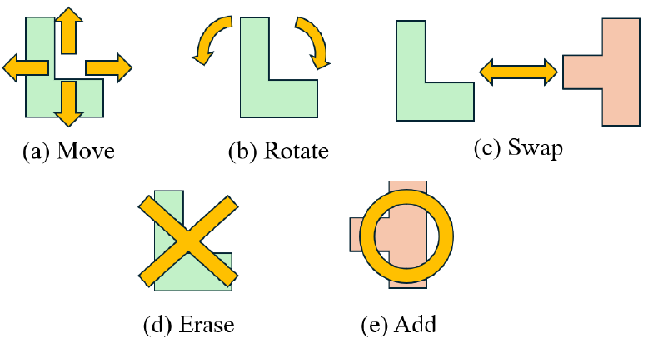
NEIGHBOR Function
Define the candidates of next state
Our definition:
Randomly select a placed polygon +
(a) Move : Randomly move ↑ or ↓ or ← or → (1 pixel)
(b) Rotate : Randomly rotate (0~360°)
(c) Swap : Randomly select unplaced polygon and swap + rotate
(d) Erase : Erase
(e) Add : Randomly select unplaced polygon and place + rotate
Notes:
For the Neighborhood function, we need to define the candidates of next state by ourselves
Therefore, we defined 5 operations:
Move, which moves a polygon randomly in one of the four directions;
Rotate, which rotates a polygon for arbitrary angle;
Swap, which randomly swaps an unplaced polygon with a placed polygon;
Erase, which erases a polygon;
and finally Add, which randomly places an unplaced polygon

Slide 18
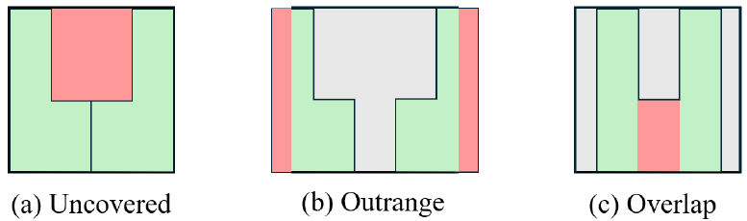
EVAL Function
Define the evaluation value of states
(Green: Polygons / Red: Penalty)
Our definition:
Inspired by the idea of “Penalty Method”
Large Penalty
Small Penalty
Constraint
(No Uncovered Area)
Actual “Waste”
(Minimization Objective)
(a)
(b)
(c)
Notes:
For the evaluation function,
Instead of simply using the value of actual waste as a penalty, we introduced an Augmented objective function.
This approach is based on the idea of the penalty method, in which a large penalty is assigned to the constraint that no uncovered area is allowed, while a small penalty is assigned to the objective corresponding to the minimization of actual waste.
and through the minimization of this function, the waste would be indirectly minimized while satisfying the constraints as much as possible

Slide 19
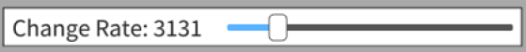
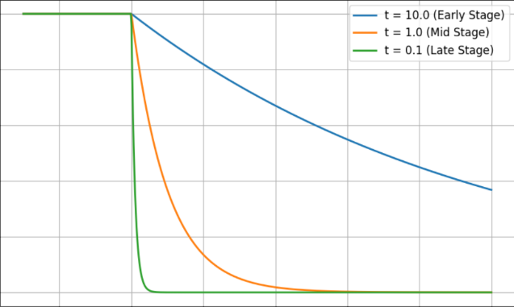

ACCEPT/TEMP Function
Related to the probability of allowing transition to worse states
■ ACCEPT Function
■ TEMP Function
1
TEMPERATURE
$$=Start+\left(end −start\right)∗(\frac{iter}{maxiter})$$
Linear Decay
High = Early stage/Low = Late stage
Start Temp = Directly Linked to Change Rate Slider
High TEMP
Transition Probability
Low TEMP
0
-
Better
Worse
+
0
Score difference
Notes:
As for the function Related to the probability of allowing transition to worse states, We have set a typical formula.
Transitions are always accepted if the score improves. When the score worsens, the probability of acceptance drops exponentially based on that change.
Using a linearly decreasing temperature, transitions to worse states are gradually suppressed as iterations proceed.
[CLICK] Here, a notable point of our study is that the Change Rate Slider is directly linked to the start temperature, which allows the theoretical parameter to be presented in an interpretable form.

Slide 20
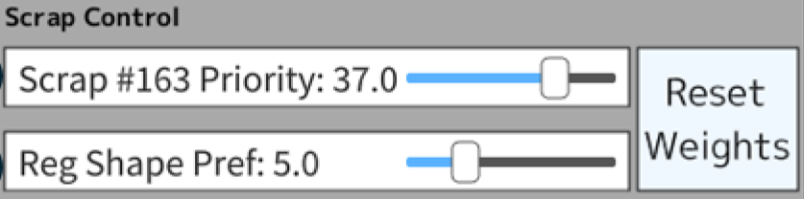
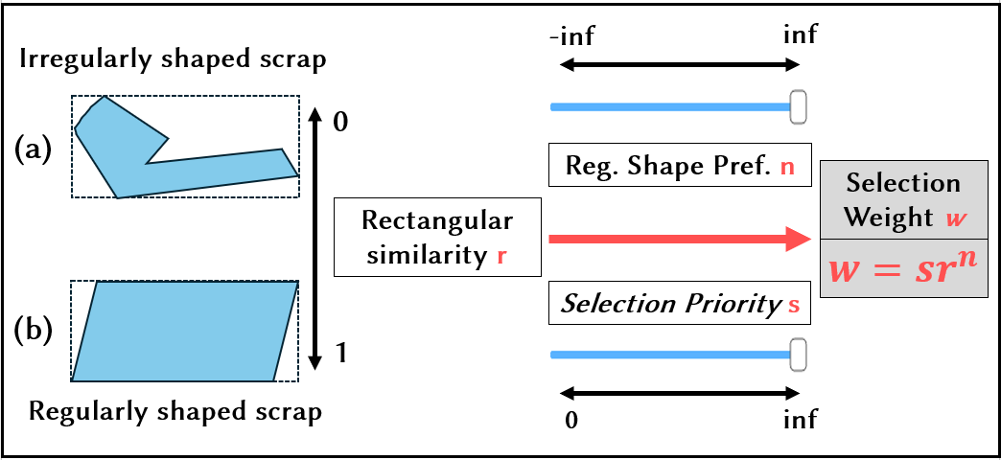
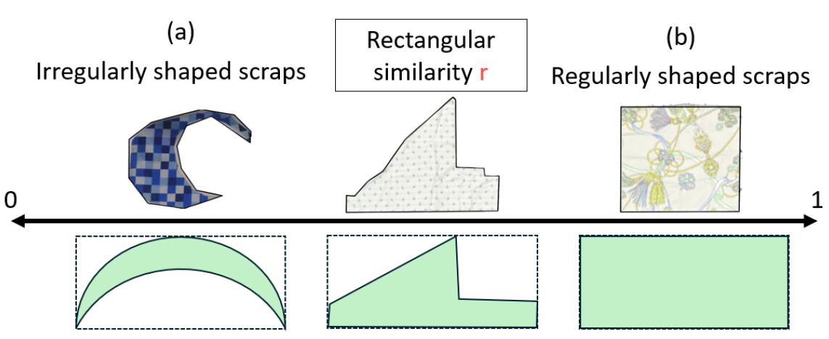
Selection Weight for Scraps
Notes:
To let users guide the layout generation through the sliders for scrap control, ScrapRecover assigns a selection weight w to each scrap by combining three factors.
First, each scrap’s rectangular similarity, r, is calculated as the occupancy rate of the scrap within its minimal bounding box. This value ranges from zero to one.
[CLICK] Then, the user specifies two parameters: the regular shape coefficient, n, using the Regular Shape Preference slider,
and the selection priority coefficient, s, using the Selection Priority slider.
[CLICK] Finally, the selection weight w is calculated as “s times r to the power of n.”
This weight is incorporated in the optimization process, and determines how likely each scrap is to be selected in the neighborhood function.

Slide 21
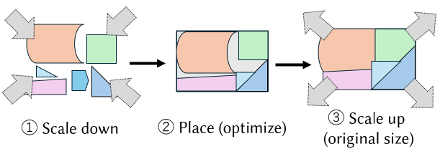
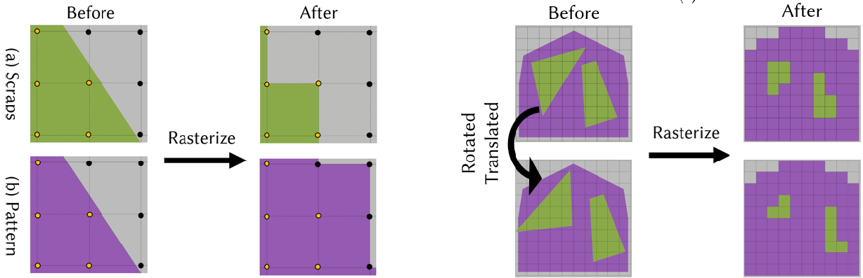
Preprocessing
■ Secure Margin for Seams
Important in practice
Slightly Shrink & Resize
■ Rasterize
Simplification of the problem through discretization
Convert every polygon into pixels (2D array) for calculations
Notes:
Besides the main optimization part, We applied several pre-processes.
First, we slightly scale down the polygons in advance to secure margins for seams, and restore them when saving the layout, as this is important for real-world fabrication.
In addition, we convert each polygon into pixels, like a two-dimensional array, for calculation at each operation.
This discretization effectively simplifies the problem.

Slide 22
Contents
■ Introduction & Background
■ System Overview: ScrapReCover
- Core Feature: Interactive Optimization
- Intuitive Controls: User-Guided Sliders
■ Optimization Method: Simulated Annealing
■ Evaluation: User Study
■ Conclusion & Future work
22
Notes:
(min~)
So, now I've presented the system.
To see how our system performs in real-world, we conducted a user study for evaluation.

Slide 23
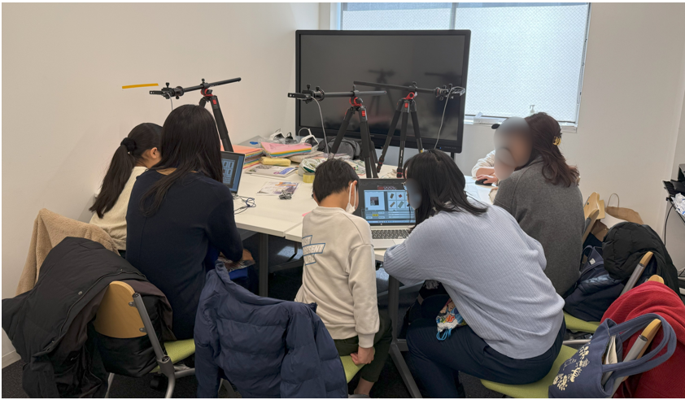
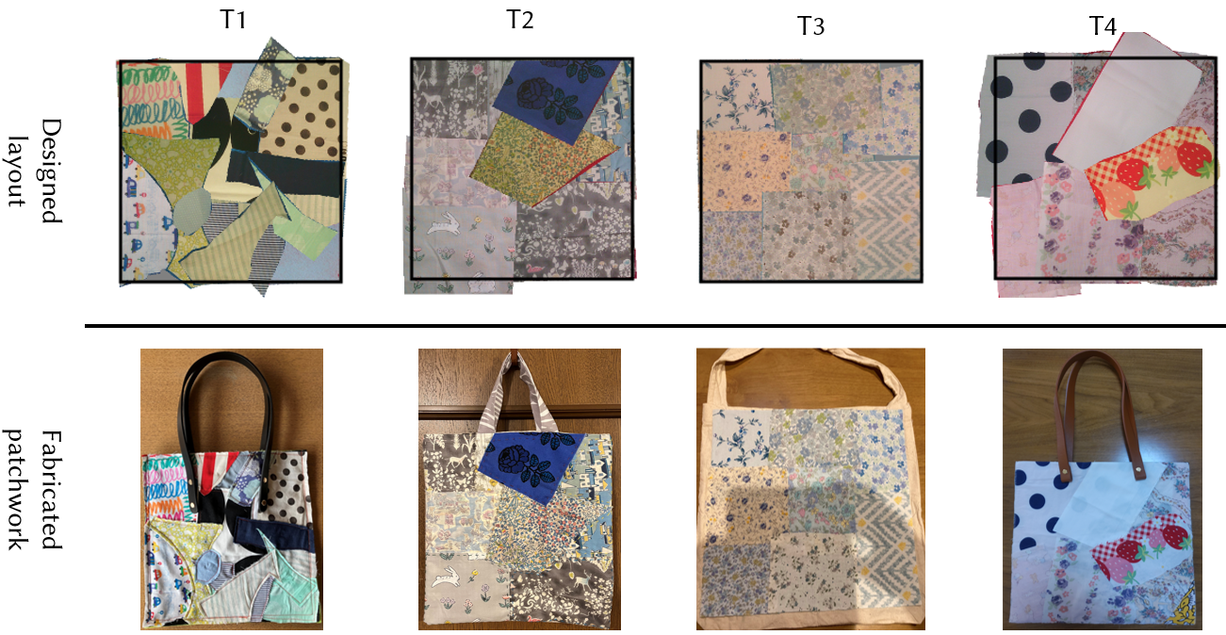
Evaluation: User Study
- 21 participants
- 45 minutes
Brought scraps from home
- Make a layout for a tote-bag (30x30 cm) through this system
Notes:
Our study involved 21 participants during a workshop.
A key aspect was that participants brought their own fabric scraps and interactively designed layouts using ScrapRecover, within a 45-minute session.
The results demonstrated the system's usability in the real world. As you can see from these examples, some participants were able to fabricate their designs into physical tote-bags.
What's notable is that while these look like professional pieces of art, they all started from scraps that would have been otherwise thrown away.

Slide 24
Feedback from The User Study
■ Pros 👍️
Helpful Initial Suggestions:
Since it is quite difficult to come up with everything from scratch,
I appreciated that the system could generate something to start with.
High Usability:
It was nice that the automatic placement seemed applicable and useful.
Even children were able to operate it.
Intuitive Manual Workflow:
I thought it was good that plotting allowed the fabric shape to be captured quite accurately.
Notes:
Now, let's take a look at the key feedback from our user study, which we've grouped into 'Pros' and 'Cons’.
Overall, the feedback on usability was quite positive. Let's start with the Pros:
[CLICK] First, participants highlighted the system's High Usability. As one user put it like: "It was nice that the automatic placement seemed applicable and useful.”
[CLICK] Second, they appreciated the Initial Suggestions. One participant said: "Since it is quite difficult to come up with everything from scratch, I appreciated that the system could generate something to start with.“
[CLICK] And third, the Manual Workflow for outlining the scraps was also well-received. One user noted: "I thought it was good that plotting allowed the fabric shape to be captured quite accurately."

Slide 25
Feedback from The User Study
■ Cons 🙅
Inconsistent Design Quality:
Sometimes the optimization results looked plain […] so it would be nice if I could provide some initial input, like ‘I want it to look this way’.
Lack of Aesthetic Consideration:
I would like the system to also recognize colors and make design suggestions […] It would be nice if styles such as cute could be added as options.
Valuing Intermediate Results:
I couldn’t manage to stop the optimization at the moment I felt, ‘This is it!’ with a design.
Notes:
The study was also essential for identifying limitations, which directly inform our future work.
[CLICK] First, some users felt the results had Inconsistent Design Quality, and wanted more control. As one user said: "it would be nice if I could provide some initial input.“
[CLICK] Second, regarding the lack of aesthetic consideration, participants wanted the system to recognize more than just the geometry and amount of the waste. For example: "I would like the system to also recognize colors and make design suggestions.“
[CLICK] Finally, users sometimes valued the optimization's intermediate results over the final outcome, implying a mismatch. For instance, one user mentioned: "I couldn’t manage to stop the optimization at the moment I felt, ‘This is it!’ with a design."

Slide 26
Contents
■ Introduction & Background
■ System Overview: ScrapReCover
- Core Feature: Interactive Optimization
- Intuitive Controls: User-Guided Sliders
■ Optimization Method: Simulated Annealing
■ Evaluation: User Study
■ Conclusion & Future work
26
Notes:
(min~)
Finally, I’d like to conclude by summarizing our contributions and outlining the future work.

Slide 27
Conclusion: Summary of Contributions
☑ ScrapReCover: An interactive tool for designing freeform layouts from irregular scraps
☑ Interactive Optimization: seamlessly blends manual control with automatic layout suggestions, guided by interpretable sliders
☑ Robust Algorithm: Leverages Simulated Annealing to minimize waste while ensuring full coverage
☑ Practical Usability: User study demonstrated effectiveness for real-world patchwork fabrication
Notes:
So, our main contributions are as follows:
First, we introduced ScrapReCover: an interactive tool designed to create freeform patchwork layouts from irregular fabric scraps.
Second, we incorporated a hybrid interaction feature that seamlessly blends the user's manual control with automatic layout suggestions, guided by interpretable sliders.
Third, we employ a robust algorithm—Simulated Annealing (SA)—to solve the complex geometric problem of minimizing waste while ensuring full coverage.
And finally, a user study confirmed the system's practical usability for real-world patchwork fabrication.

Slide 28
Future Directions
◎ Design Aspect
- Color combination/Target image guidance
- Design direction specification
◎ 3D Aspect (2D → 3D version problem)
- Modify the (currently predefined) pattern simultaneously
◎ Feasibility of the fabrication
- Consider seam length/curvature
Notes:
Finally, as the last part of my presentation, I'd like to discuss the future work.
We see three main directions:
First, about the Design Aspect: It is important to allow users to specify design preferences, like color combinations or a target image, to better guide the optimization.
Second, about the 3D Aspect: It is also interesting to address the 3D version problem. Enabling simultaneous modification of the currently fixed pattern itself should be a key to yielding more flexible results.
And third, about Fabrication Feasibility: It is essential to consider practical fabrication metrics—like seam length and curvature of scraps—to improve real-world usability.

Slide 29

Thank You for
Your Attention!
Please feel free to ask questions!
▼PROJECT PAGE▼
Notes:
(OK to only show)
Thank you very much for your attention. I would be happy to take any questions.

