Slide 1
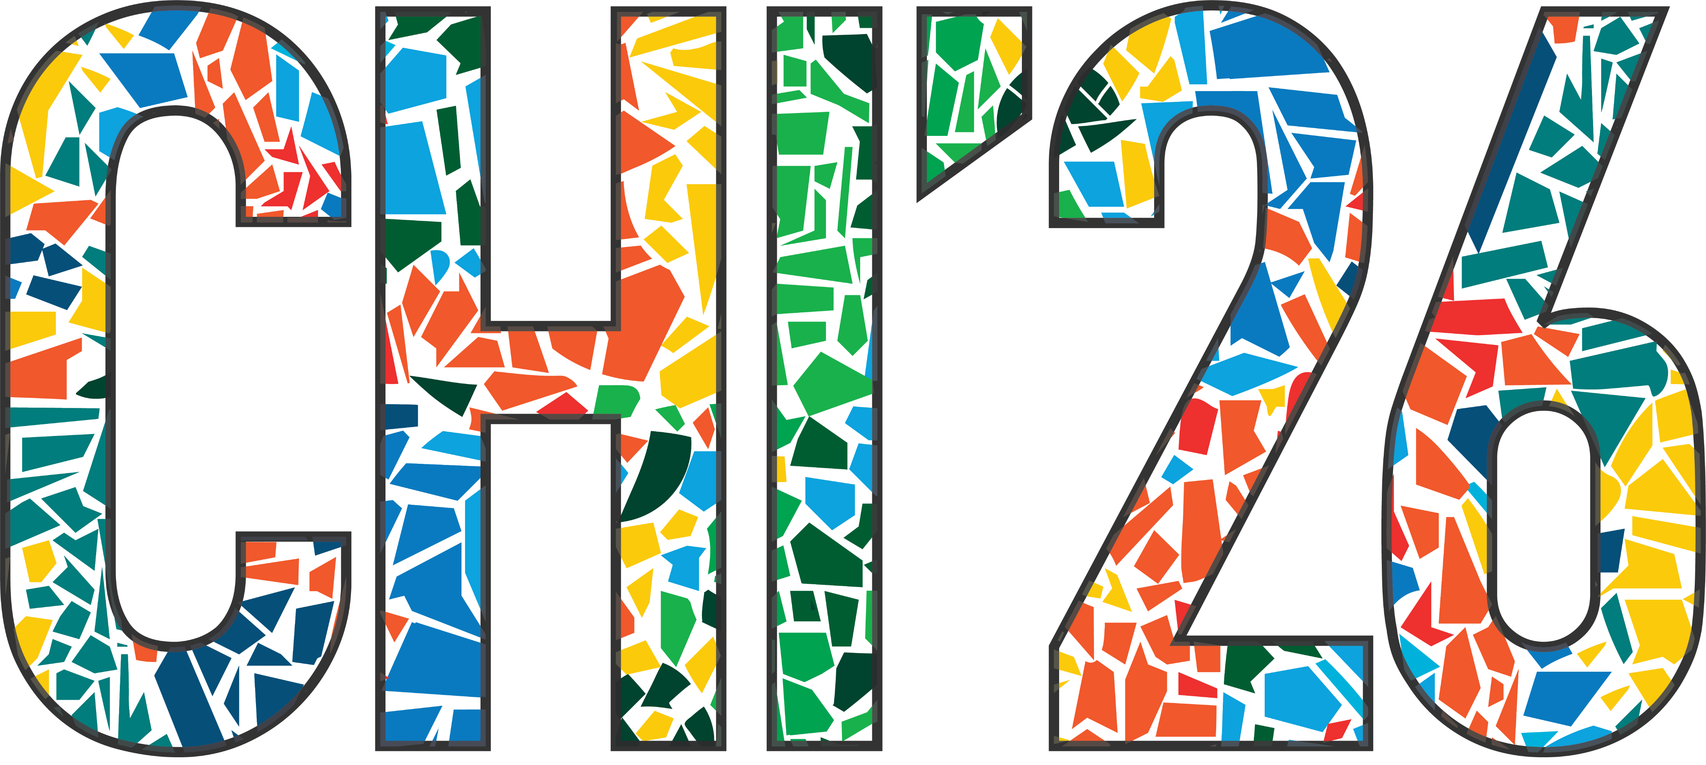


No Pixel Left Behind:
Filling Gaps in Anime Colorization
Masahiro Kono¹ Akinobu Maejima² Yuki Koyama¹
Yotam Sechayk¹ Takeo Igarashi¹
^{1: The University of Tokyo}
2: OLM Digital, Inc./IMAGICA GROUP, Inc
Notes:
Hello everyone. My name is Masahiro Kono, and I am from the Igarashi Lab at The University of Tokyo.
Today, I would like to present my work, No Pixel Left Behind: Filling Gaps in Anime Colorization

Slide 2
Contents
■ Introduction & Background
■ Proposed Tool: “GapFill”
- UI / Automatic Color Prediction Method
■ Evaluation & Discussion: User Study
■ Conclusion & Future Work
Notes:
And, here is the outline for today's presentation.
First, I'll begin with the Introduction and Background.

Slide 3
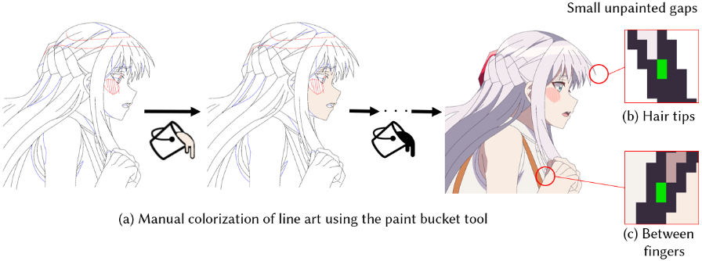
Background・Problem Setting
Small enclosed regions (green) become “unpainted gaps”
Paint bucket colorization for anime fills each enclosed region with a flat color
- In the anime “shiage” (finishing), manual paint bucket colorization remains the standard workflow.
- “Unpainted gaps” frequently occur in sharp-angled areas (e.g. hair tips) and are tedious to detect and fill.
→ We aim to address this challenge with a tool designed for production support.
Notes:
In anime shiage, or finishing, colorists usually fill each enclosed region with a flat color using the paint bucket tool.
However, this process often leaves tiny enclosed areas unpainted. We refer to these as unpainted gaps, shown in green in this figure.
These gaps often appear in sharp regions, such as hair tips, and are tedious for artists to detect and fill manually.
To address this issue, we propose a production-oriented support tool for anime colorization.

Slide 4
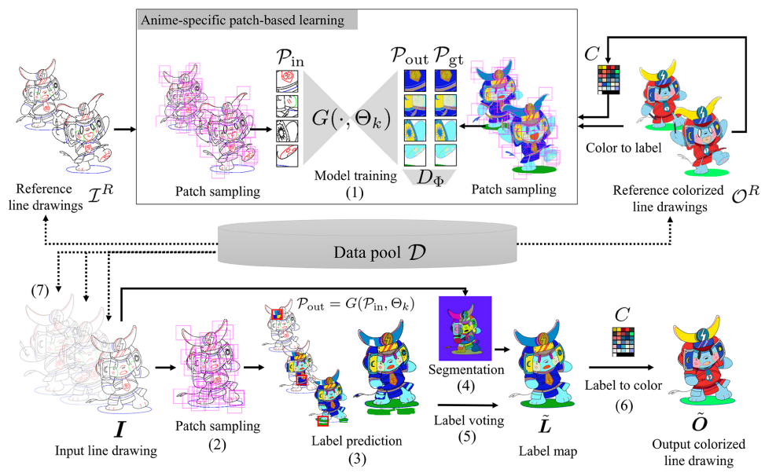
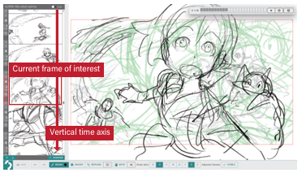
Related Work (Example)
■ Automatic colorization for line art
■ Support tool for anime production
Continual few-shot patch-based learning for anime-style colorization [Maejima+ ‘24]
Griffith: A storyboarding tool designed with Japanese animation professionals [Kato+ ‘24]
Recently, deep learning–based approaches have become mainstream
However, prediction accuracy for small regions remains insufficient
Gap between research and practice:
Limited focus on practical adoption
Existing tools are insufficient for unpainted gaps
Notes:
This slide reviews two representative directions in related work.
First, automatic line art colorization has been studied for many years, and recent approaches are mostly based on deep learning. However, small regions remain difficult to predict accurately.
Second, research grounded in real anime production workflows remains limited. As a result, there is still a gap between research and practice, and unpainted gaps are not yet well addressed in production.

Slide 5

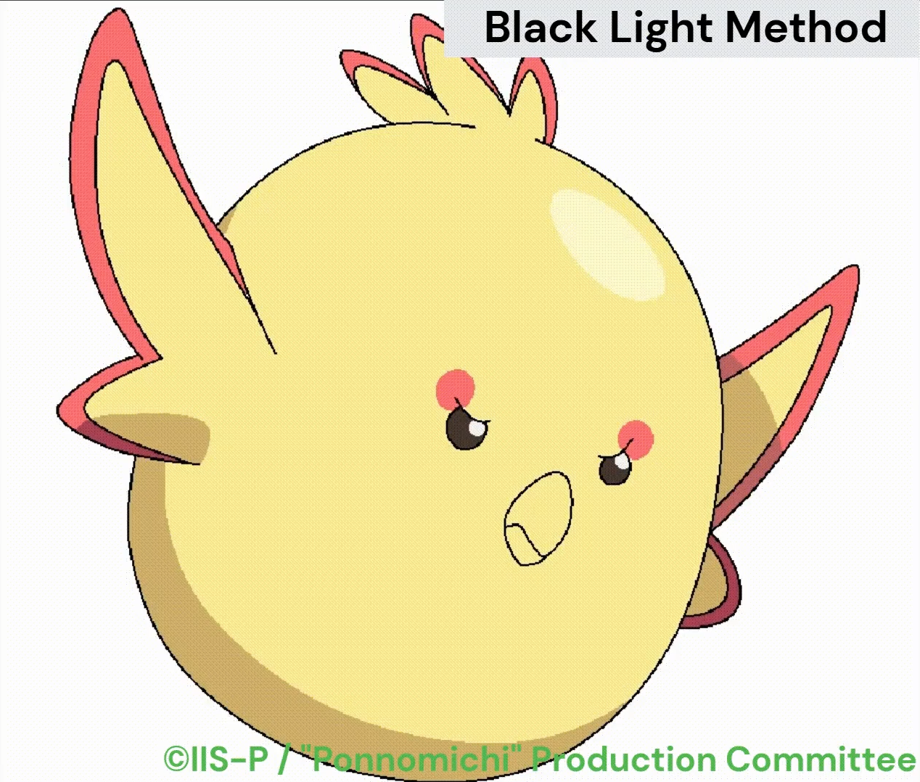
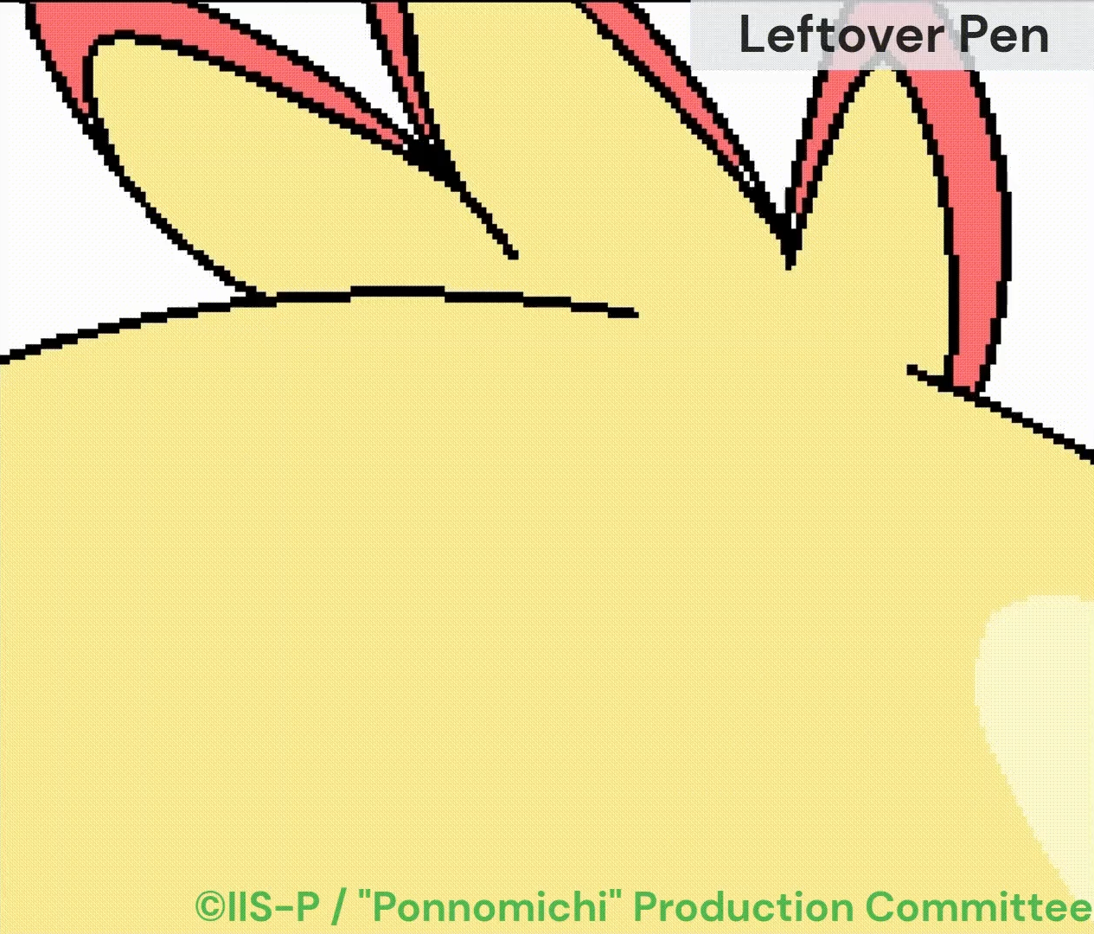

Existing Methods/Tools
■ Black Light Method🔍️
■ Leftover Pen🖌️
■ Enclose and Fill➰️
The repetitive cycle of
“detection 👀”
“zooming 🔍”
“color selection 🎨”
remains unavoidable!
Support for detection👀
Temporarily replace all colors with black; unpainted gaps stand out as white dots.
Support for correction✍️
Fill all enclosed areas along the brush stroke with the specified color
Support for correction✍️
Fill all enclosed areas within a lasso-selected area with the specified color
Notes:
Next, I would like to introduce the methods and tools to handle unpainted gaps, as identified through our formative study.
Based on our observation, professionals commonly relied on three approaches in CLIP STUDIO PAINT: the Black Light Method, Leftover Pen, and Enclose and Fill.
First, the Black Light Method helps with detection by temporarily replacing all colors with black, so that unpainted gaps appear as white dots.
Second, the Leftover Pen helps with correction by filling unpainted areas along the brush stroke with a specified color.
And Third, the Enclose and Fill also helps with correction by filling enclosed regions inside a lasso-selected area.
However, even with these tools, colorists still need to repeat three manual steps: detection, zooming, and color selection; We aim to reduce this burden.

Slide 6
Contents
■ Introduction & Background
■ Proposed Tool: “GapFill”
- UI / Automatic Color Prediction Method
■ Evaluation & Discussion: User Study
■ Conclusion & Future Work
Notes:
Now, let's move on to the the main part — the overview of the Features of GapFill.

Slide 7
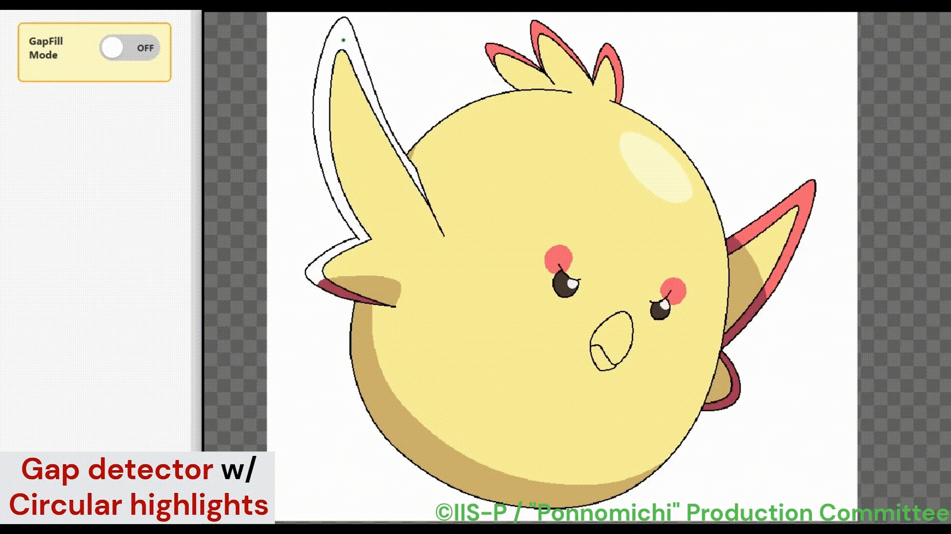
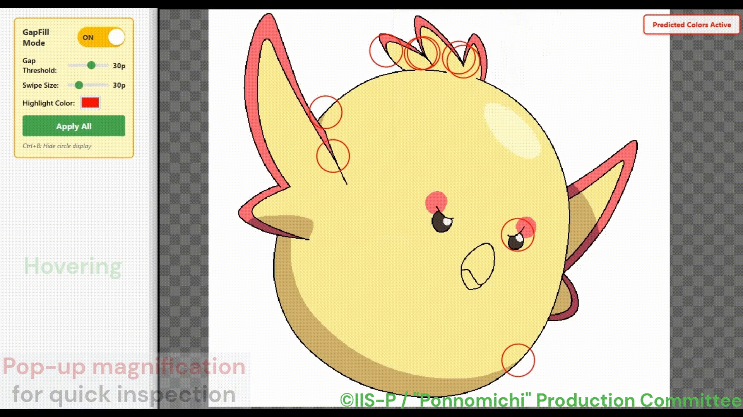
UI/Features of “GapFill”
■ Automatic detection/color suggestion and highlighting of unpainted gaps
■ Hover-activated pop-up magnification
- Automatically detect small unpainted gaps using BFS
- Visualize them with markers, reducing manual detection👀
- Temporarily overlay suggested colors using deep learning
- Reduce manual color selection 🎨
- Show a local magnified view while the cursor is inside the circle
- Allow users to quickly inspect predictions, reducing manual zooming 🔍
Notes:
The GapFill interface consists of five main interactive features.
First, the Unpainted Gap Detector automatically detects enclosed unpainted regions and highlights them with circles. This reduces the effort required for manual detection.
Second, Automatic Color Suggestion temporarily overlays each detected gap with a suggested fill color. This reduces the effort required for manual color selection.
Third, Hover-Activated Pop-up Magnification allows users to inspect the local result quickly, without the need of manually zooming in and out.

Slide 8
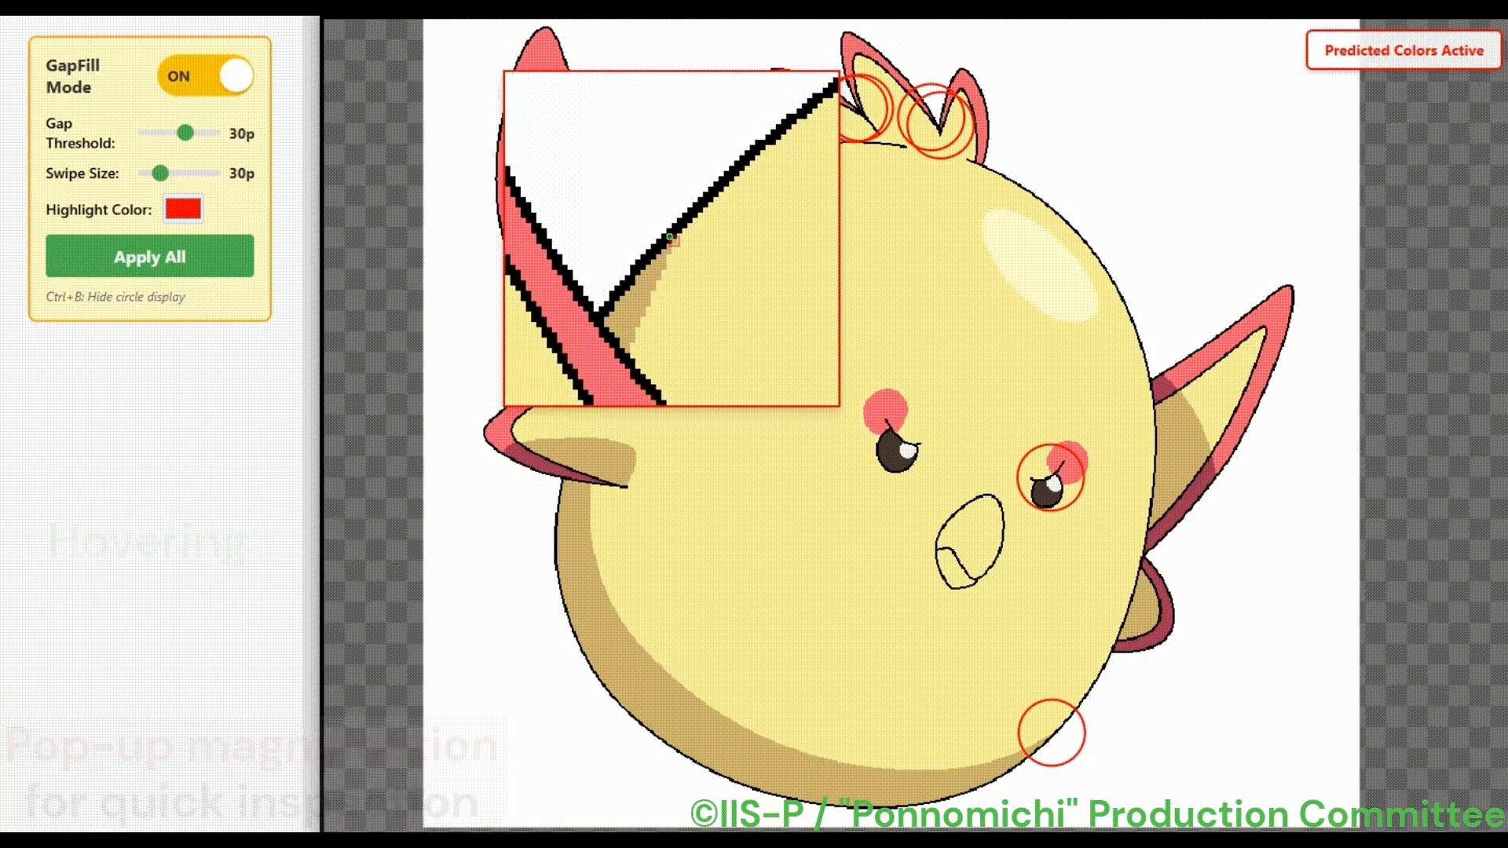
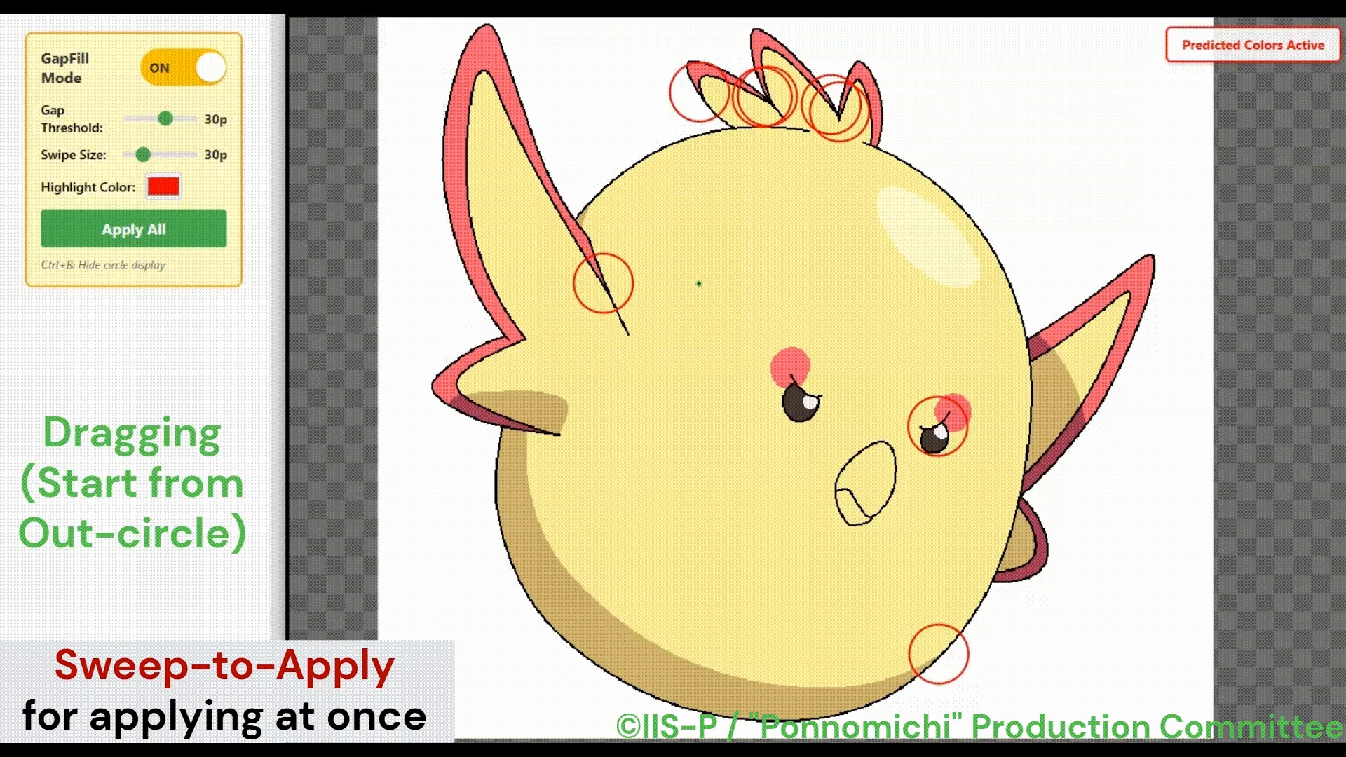
UI/Features of “GapFill”
■ In-Circle Color-pick for Correcting AI Suggested Colors
■ Out-Circle Sweep-to-Apply and Apply-All Button
- If a prediction is wrong, start dragging inside the circle
- Correct the suggestion by manually selecting a nearby color
- Color-picker-like interaction with low cognitive load
- If predictions are correct, start dragging outside the circle
- Apply colors in batch to the circles crossed by the stroke
- An Apply-All button is also provided
Notes:
And, if a suggested color appears incorrect, the user can drag inside the circle and correct it by selecting a nearby color through a color-picker-like interaction.
Finally, if the suggestions seems to be correct, the user can drag outside the circle to apply suggested colors in batch with a brush-like gesture, or confirm all predictions at once using the Apply-All button.

Slide 9
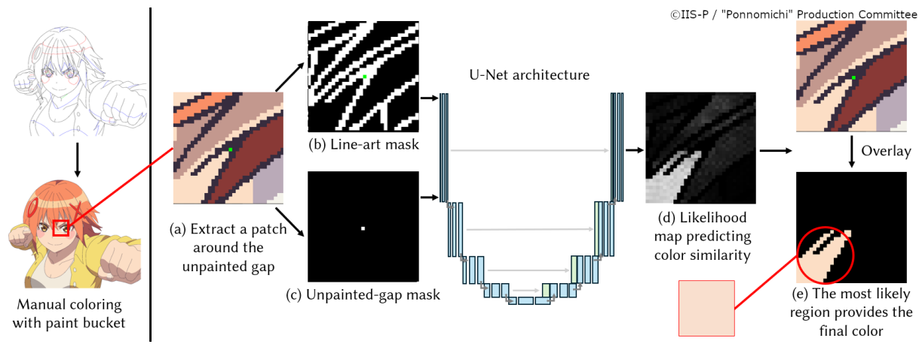
Automatic Color Prediction Method
■ Approach: Indirect color prediction by learning region-to-region correspondence
- More robust than directly regressing colors
- Effectively leverage the flat-color nature of anime images
- The occurrence of unpainted gaps is independent of color
- Estimate which surrounding large region shares the same color as the target gap
Notes:
Next, I would like to briefly explain our novel automatic color prediction method.
Our key idea is to predict colors indirectly by learning region-to-region correspondence, which makes the model more robust.
This design is motivated by the flat-color nature of anime images and by the fact that unpainted gaps themselves are independent of any specific color.
In other words, instead of directly regressing colors, the model estimates which surrounding large region is most likely to share the same color as the target gap.

Slide 10
Contents
■ Introduction & Background
■ Proposed Tool: “GapFill”
- UI / Automatic Color Prediction Method
■ Evaluation & Discussion: User Study
■ Conclusion & Future Work
Notes:
Now, let’s move on to the evaluation and discussion, based on our user study.

Slide 11
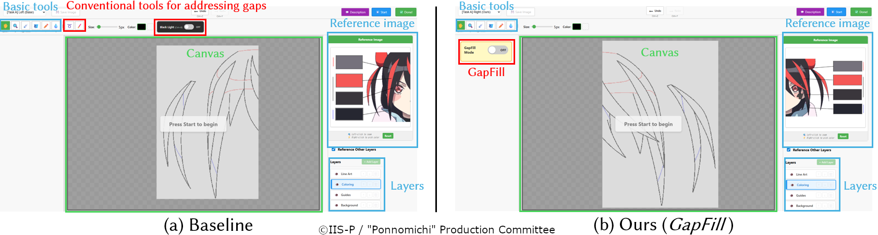
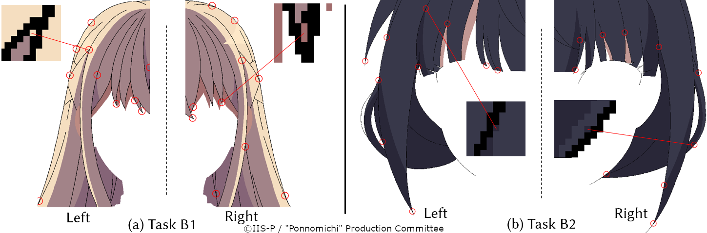
Overview of the User Study
■ Images
Near-symmetric anime images containing hair, split into halves
→ reduce learning effects and image differences (fair comparison)
■ Task overview
- Task A (regular colorization):
freely color real line art from scratch
- Task B (final checking):
focus on unpainted gaps in nearly finished images
- Task C: Subjective Evaluation of our color prediction method itself
Notes:
To evaluate usability, we conducted a user study with 13 professional anime colorists using custom-made painting software similar to a real production environment.
For a fair comparison, we used near-symmetric anime images containing hair and split them into left and right halves.
The study mainly consisted of three types of tasks:
In Task A, participants colored real line art from scratch.
In Task B, they detected and filled intentionally set unpainted gaps in almost fully colored images.
In Task C, they subjectively evaluated batch-applied color predictions for small enclosed regions.

Slide 12
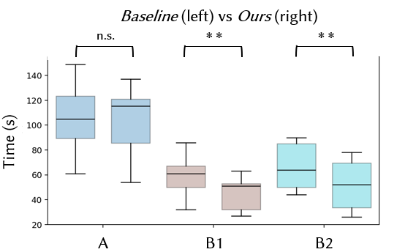
Results: Evaluation of Tool Usability
■ Quantitative evaluation
■ Qualitative evaluation (overview)
＋Overall, GapFill was rated more favorably than existing tools
＋Especially strong support in the final checking (Task B)
＋Visual aids (detection/magnification) prevents overlooked gaps
－In Task A, existing tools can be easier for filling large areas and multiple gaps at once
－Some participants did not fully trust AI-generated outputs
± Several participants wanted to use both systems together
Completion time:
significantly reduced in Task Bs at α = .01
Overlooked gaps:
GapFill performed better in both tasks
(0 remaining gaps)
Notes:
This slide summarizes the usability results.
Quantitatively, GapFill significantly reduced completion time in Task B for both images. It also outperformed the baseline in terms of missed gaps, leaving zero remaining gaps.
Qualitatively, participants generally rated GapFill as more practical for adoption than existing tools, especially in final-checking scenarios like Task B, where preventing missed gaps is particularly important. In this setting, its visual support features were especially well received.
By contrast, in more general colorization scenarios like Task A, there were larger individual differences. One possible reason is that existing tools can be more efficient for filling large areas and multiple gaps at once.
This also led several participants to suggest that GapFill should be used together with existing tools, rather than as a replacement, since each has its own strengths.

Slide 13
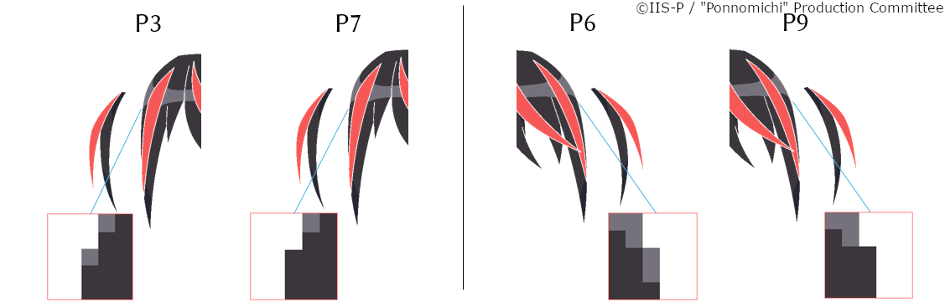
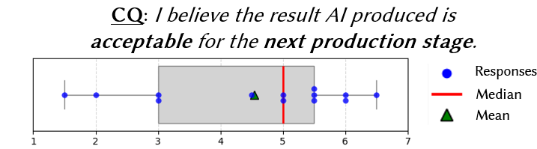
Discussion: Contribution of Prediction Accuracy
Task A
Task C
■ Participants expressed diverse views on accuracy:
＋ AI mistakes are tolerated if user keeps control
－ Once even a single mistake is noticed, trust in the remaining outputs may decrease
± Acceptability also depends on the deadline
■ Observations from Tasks A and C:
- Task A: gaps were sometimes filled with different colors
→ no visible difference; maybe multiple “answers”?
- Task C: positive but not perfect (median: 5/7)
→ salient regions, such as the pupils, still require correctness
★ “Accuracy” should be reconsidered (consider context etc.)
★ Tool usability is influenced not only by accuracy, but also by manual control, trust in AI, and production context
Notes:
Now, I would like to discuss an interesting insight about the role of prediction accuracy in tool usability.
This relationship seems more complex than the numerical results, as participants expressed diverse views on accuracy.
Some said that AI mistakes are acceptable as long as they can be corrected quickly and the user stays in control.
Others, however, said that even a single visible mistake could reduce their trust in the remaining outputs.
They also noted that the acceptable level of accuracy depends on the production deadline.
This suggests that tool usability depends not only on prediction accuracy, but also on manual control, trust in AI, and the production context.
In the first place, We hypothesized that, for tiny regions, there may be more than one visually acceptable color choice.
In Task A, we observed cases where gaps were filled with different colors, yet no visible difference was produced. This suggests that a single correct answer may not always be necessary.
On the other hand, at the same time, the subjective evaluation in Task C was not perfect, with a median score of 5 out of 7.
Here, participants especially pointed out that salient regions, such as the pupils, still require correctness.
Taken together, these findings suggest that “accuracy” itself may need to be reconsidered in a more context-sensitive way.

Slide 14
Contents
■ Introduction & Background
■ Proposed Tool: “GapFill”
- UI / Automatic Color Prediction Method
■ Evaluation & Discussion: User Study
■ Conclusion & Future Work
Notes:
Finally, I’d like to conclude by summarizing our contributions and outlining the future work.

Slide 15
Conclusion
■ Summary of contributions💡
- Conducted a formative study and identified the challenge of unpainted gaps
- Proposed “GapFill,” a production-oriented support tool for handling unpainted gaps
- Introduced a novel deep-learning-based color prediction method for such gaps
- Evaluated the proposed tool and obtained new insights into creativity support tools
■ Future directions🔎
- Improve prediction accuracy in important regions, such as the pupils
- Redefine an evaluation metrics (“accuracy”) based on perceptual quality
- Develop a practical tool with stronger integration into existing tools and workflows
Notes:
Our contributions are fourfold: we conducted a formative study and identified the challenge of unpainted gaps, proposed GapFill as a production-oriented support tool, introduced a novel deep-learning-based color prediction method for small gaps, and evaluated the proposed tool trough a user study, while obtaining new insights into creativity support tools.
For future work, we plan to improve prediction accuracy in important regions such as the pupils, develop new evaluation metrics for accuracy based on perceptual quality, and further develop the system toward practical deployment with stronger integration into existing tools and workflows.

Slide 16
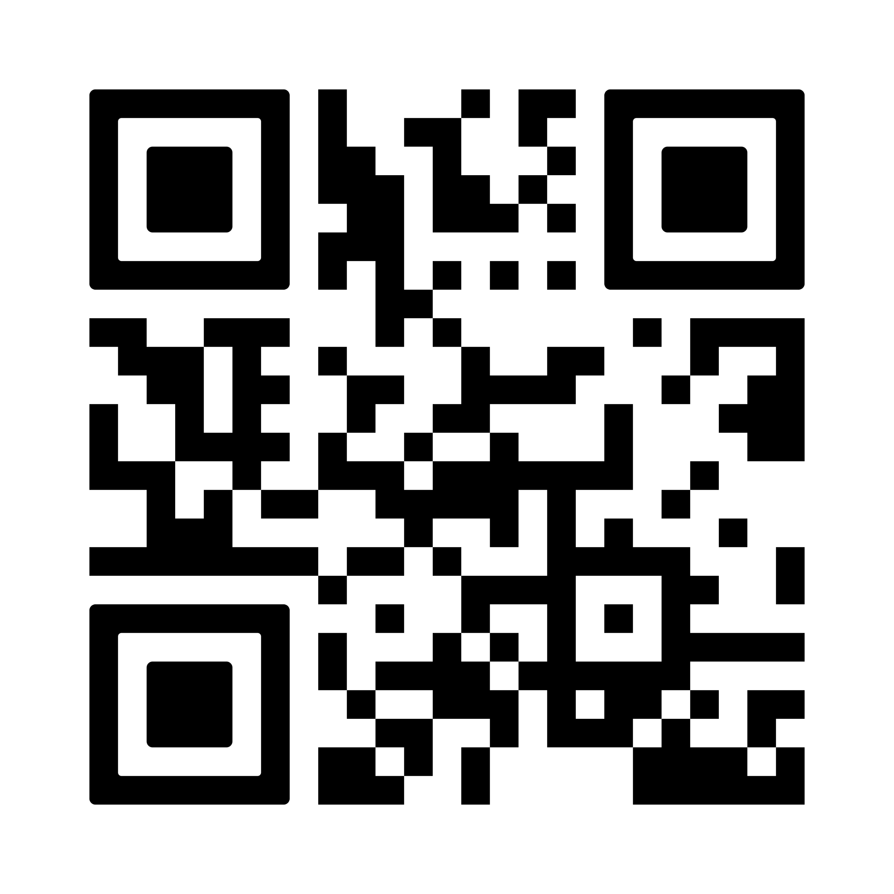
Thank You for Your Attention!
Project page (code refactoring in progress)
Notes:
Thank you for your Attention!

Slide 19
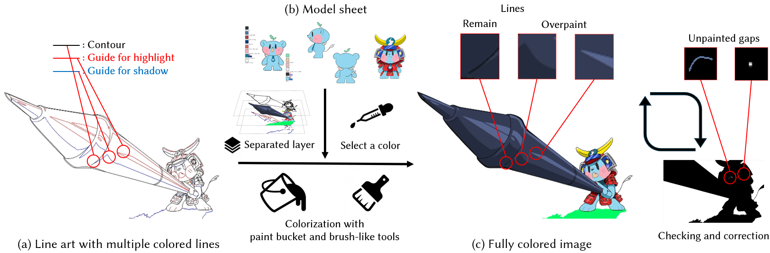
Formative Study
- Subject: professional colorists in anime production
- Method: semi-structured interviews and workflow observation
- Objective: Understanding the overall anime colorization workflow, current methods for handling unpainted gaps, and identifying the underlying challenges and requirements.
Colorization workflow: Applying specified flat colors to completed line art
※ Line art is binary
※ Additional visual effects are added in the subsequent stage
Notes:
To better understand real production practice, we first conducted a formative study.
Here, We worked with professional colorists in anime production and used semi-structured interviews together with workflow observation.
The goal was to understand the overall colorization workflow, how unpainted gaps are currently handled, and what challenges and requirements exist in real production.
It revealed that the colorization workflow consists of applying flat colors to completed binary line art, after which the colored frames are passed to the subsequent composition stage.

Slide 20
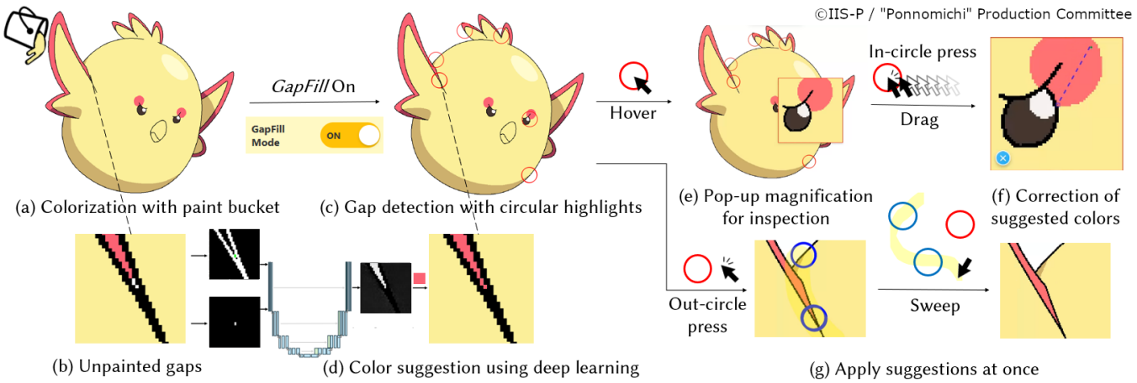
Design Principles of “GapFill”
Reduce the repetitive cycle of detection 👀, zooming 🔍, and color selection🎨
Suggest fill colors based on local context, such as neighboring colors
Provide simple and intuitive interactions that fit naturally into diverse existing workflows
Preserve room for manual control over the output, rather than pursuing full automation
Notes:
Before introducing the features, I would like to explain the design principles of GapFill.
Based on our formative study, we designed the tool to reduce the repetitive cycle of detection, zooming, and color selection.
Besides that, we also wanted the tool to suggest colors from local context, fit naturally into existing workflows through simple and intuitive interactions, and preserve human control rather than aiming for full automation.

Slide 21
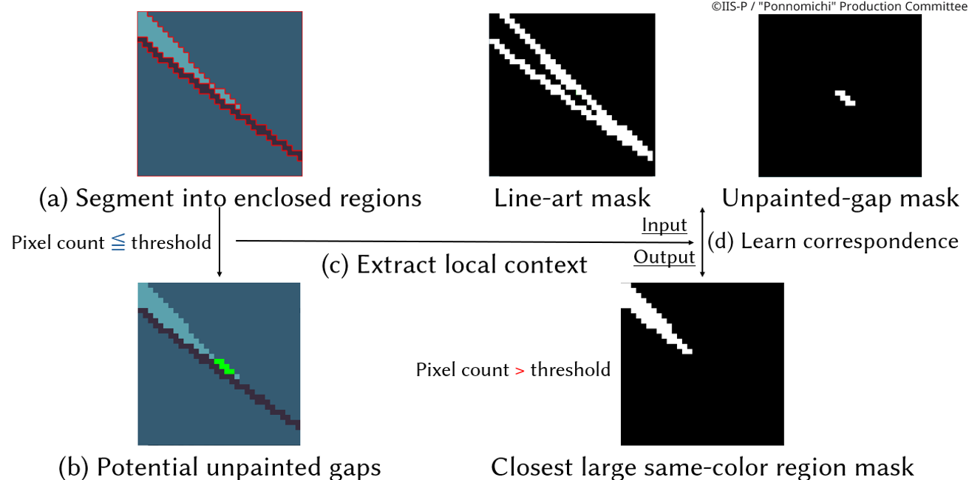
Training Data Preparation
- Segment enclosed regions from a broadcast-anime image set (line art/colored)
- Treat small enclosed regions below a threshold as “potential unpainted gaps”
- Learn the correspondence to the nearest large same-color region
Notes:
I would also like to explain how we prepared the training data.
First, From a broadcast-anime image set containing both line art and colored images, we extracted the lines and segmented it into enclosed regions.
Then, we treated small enclosed regions below a threshold as potential unpainted gaps.
Finally, Using these examples, we trained the model to learn the correspondence between each target gap and the nearest large region with the same color.

Slide 22
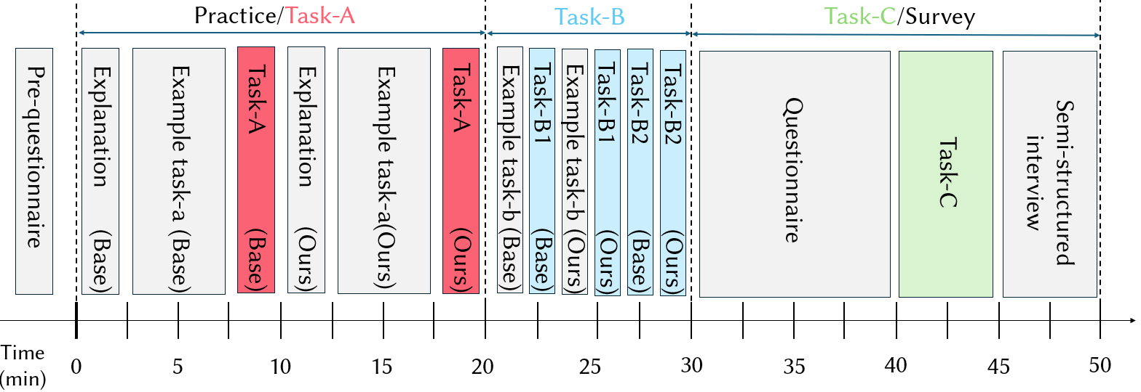
Overview of the User Study
■ Participants: 13 professional anime colorists
■ Environment: a custom painting tool that simulates the production environment (Clip Studio Paint)
■ Tasks: quantitative comparison between existing tools and GapFill using completion time etc.
■ Qualitative evaluation: feature-level analysis, questionnaires, and semi-structured interviews
※ The color prediction method itself was also separately evaluated from the usability of the tool
Notes:
The overview of the user study is as follows:
We conducted a user study with 13 professional anime colorists.
and For the study, we used a custom painting tool that simulates the basic functions and production environment of the industry-standard Clip studio paint.
Then, We quantitatively compared existing tools and GapFill using completion time and the number of overlooked gaps, and we also collected qualitative feedback through feature-level analysis, questionnaires, and semi-structured interviews.
In addition, we evaluated the color prediction method itself separately from the usability of the tool.

Slide 23
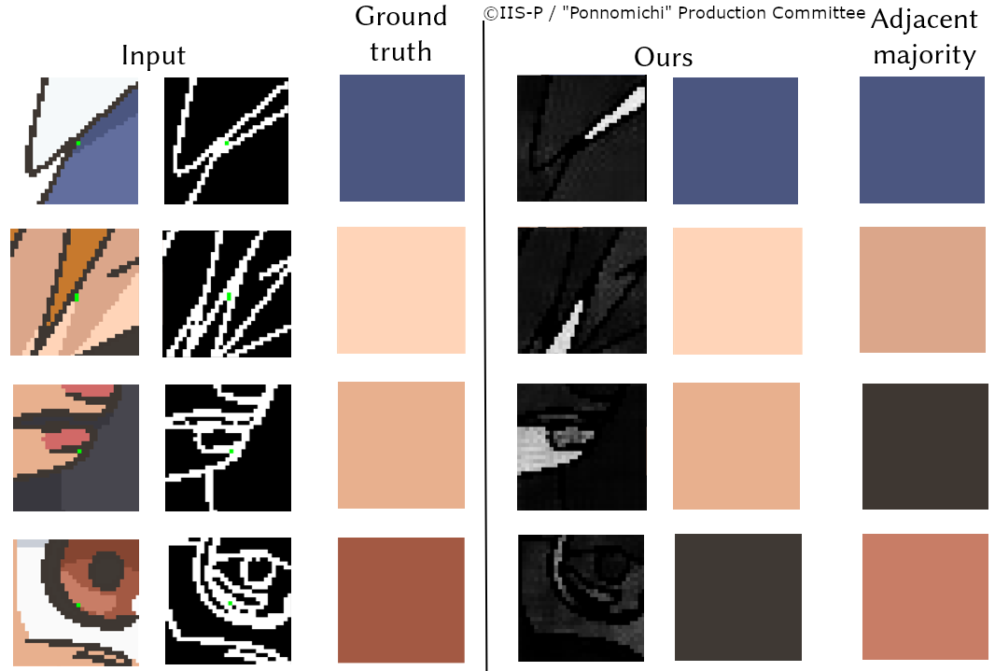
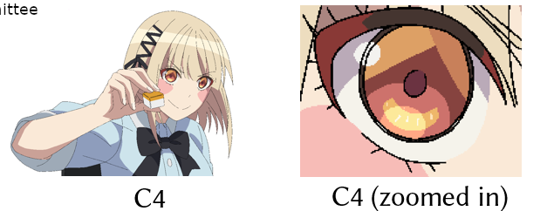
Evaluation of the Color Prediction Method
■ Subjective evaluation (Task C)
■ Objective evaluation
- Hypothesis: for very small regions, choosing any adjacent color may be visually acceptable (multiple acceptable answers)
- Task C: predicted colors were applied in batch to small enclosed regions and then visually evaluated for usefulness
- Result: generally positive tendency (median = 5/7)
- Accuracy: 81.68% for our method on unseen data
vs. 37.02% for a greedy adjacent-majority baseline
- Inference time: 74 ms/patch (real-time use ◎)
Notes:
Next I would like to talk elaborate on the evaluation of the color prediction method itself, including additional Task C.
Our hypothesis was that for very small regions, there may be more than one visually acceptable color choice.
Therefore, Based on this idea, we designed Task C, where predicted colors were applied in batch to small enclosed regions and then visually evaluated for usefulness.
And The subjective evaluation showed a generally positive tendency, with a median score of 5 out of 7.
In the objective evaluation, our method achieved 81.68 percent accuracy on unseen data, compared with 37.02 percent for a greedy adjacent-majority baseline, while maintaining real-time speed at 74 milliseconds per patch.

Slide 24
Insight: Trust in AI and Integration with Existing Tools
■ Limits of trust in AI
Even when the AI indicated completion, some still manually checked using the Black Light Method
Several participants emphasized that final quality assurance must still remain in human hands
→ reflecting caution toward an unfamiliar AI tool and the professional responsibility for the final output
■ A possible direction: aim for integration, not replacement
Many preferred using GapFill together with existing tools, rather than fully replacing them
Transitioning to a new workflow introduces learning cost and friction
→ Complementary workflow that combines the strengths of each tool may be essential for real adoption
Notes:
The second topic is about trust in AI and the possibility of integrating GapFill with existing tools.
Participants showed Limits of trust towards AI-powered tools.
Even when the AI indicated completion, some participants still manually checked the result using the Black Light method.
Moreover, Several participants emphasized that final quality assurance must still remain in human hands
This reflects both caution toward an unfamiliar AI tool and the strong professional responsibility of colorists for the final output.
However, this problem may be addressable.
As some participants mentioned, they would like to use GapFill together with existing tools, rather than fully replacing them.
Besides that, they also said Transitioning to a new workflow introduces learning cost and friction
Therefore, a possible direction is to aim for integration and design a more complementary workflow that combines the strengths of GapFill and existing tools, which promotes adoption in real production.

